Slide 1
World War One
The Great One
The War to End All Wars
Making the world safe for democracy
1914-1918

Slide 2
How did the War begin?
Assassination of Archduke Franz Ferdinand by a Serbian nationalist ignited the powder keg of the Balkans.
Overlapping alliances forced countries to take sides and honor commitments to support each other.

Slide 3
What were they fighting about? The 4 MAIN Reasons
Militarism-countries ready and willing to go to war, glorification of war
Alliances-conflict of interest between allies
Imperialism-European rivalries extended to their territories in the race for land
Nationalism-extreme loyalty to the homeland, especially in the Balkans

Slide 4
Who was fighting who?
Central Powers
Triple Alliance:
Germany
Austria-Hungary
Ottoman Empire (Turkey)
Allied Powers
Triple Entente
United Kingdom
France (overrun by Germany early in the war)
Russia (withdrew after the Russian Revolution)
United States (entered in 1917 after sinking of the Lusitania)
Italy joined in 1915

Slide 5
Where did they fight?
Western Front across France
Battle of the Marne
Battle of the Sommes
Ypres
Verdun
Asia and Africa-
German possessions attacked/overrun
Eastern Front-
across Russia
Balkan front-
Gallipoli
Italian front

Slide 6
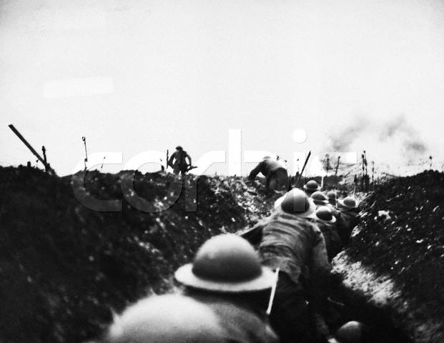
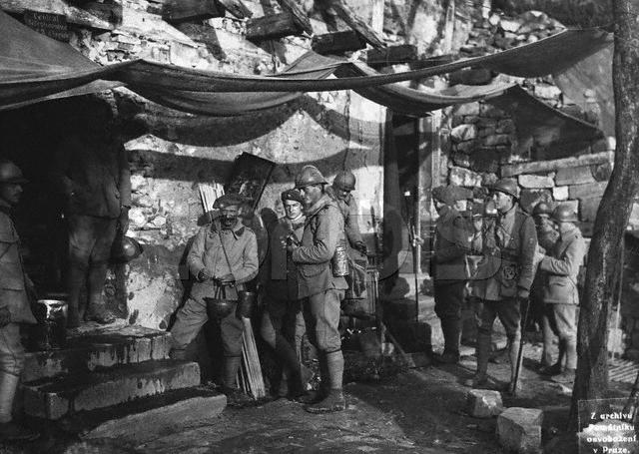
How did they fight? Trench warfare: Problem
Entrenched forces, surrounded by barbed wire, protected by machine gunners, were extremely difficult and costly to dislodge, resulted in lengthy stalemates and a war of attrition.

Slide 7
Solution::
Fire poison gases over opposing trenches to either disable or force soldiers out.
New Problem: the gas often drifted back over onto their own troops
Solution: gas masks for all, even horses

Slide 8
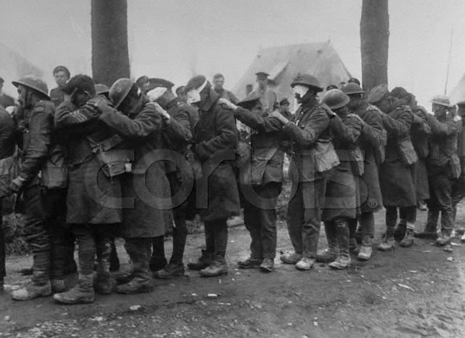
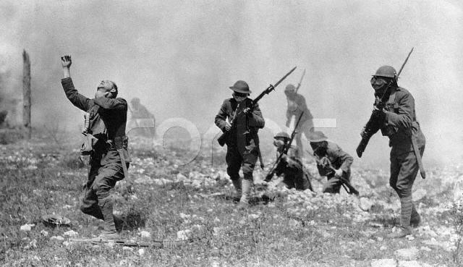
Poison Gases
Horrible, choking gas was a terrible way to die, weeping fluid from every pore.
Thousands of troops were
blinded by gases.

Slide 9
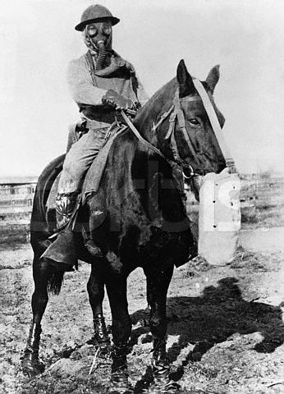
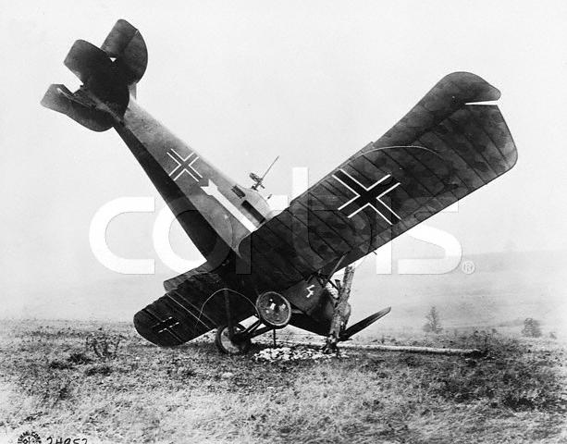
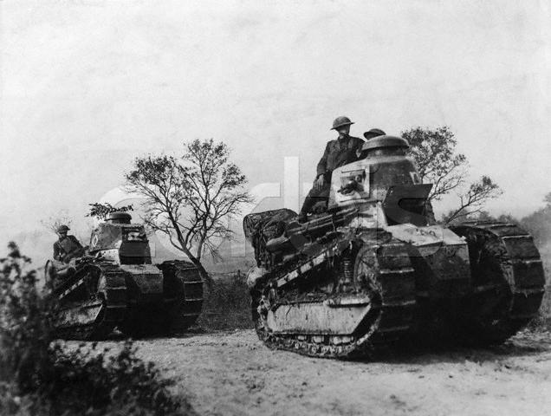
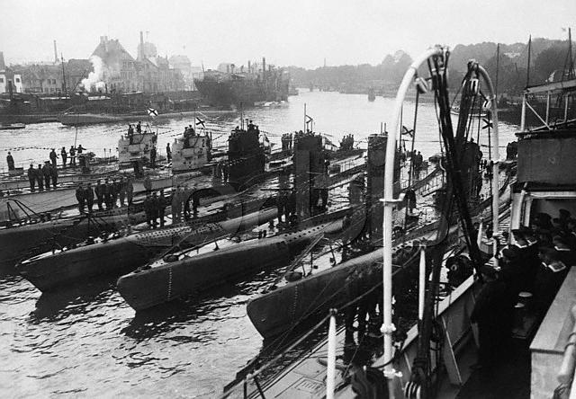
Weapons
New: aircraft
Horses, dogs, pigeons
Formidable Tanks
Deadly u-boats

Slide 10
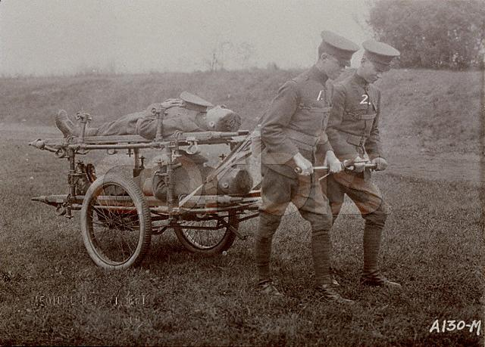
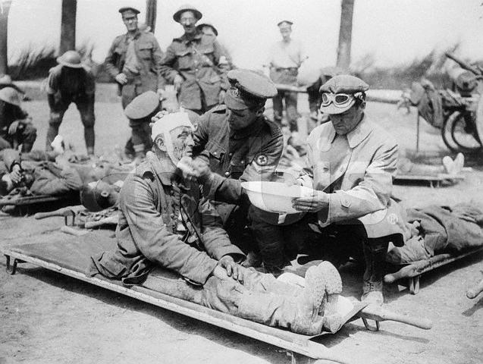
Care of Wounded
Primitive transportation and poor sanitation meant thousands of needless deaths.
“Gentleman” volunteers drove ambulances, including many American writers, such as Hemmingway

Slide 11
Total War
Unlike previous wars, World War One was a “total” war in which nations mobilized all their resources toward waging war.
Rationing and sacrifice at home
Citizen volunteer soldiers-”Pal” regiments
Women mobilized to serve and work

Slide 12
U-BOATS - Problem:
Silent, unseen, deadly German u-boats prowled the North Atlantic, sinking ships bound for hungry England.

Slide 13
Solution:
Allied merchant marines and navies formed convoys crossing the Atlantic with armed escorts.

Slide 14
The US enters the war
German u-boats sank the
British passenger ship
Lusitania in 1915. 1,198 1,938 passengers died,
including 139 Americans
Germany also attempted to convince Mexico to divert US attention by attacking us in return for returning New Mexico and Arizona. Ambassador Zimmerman’s telegram intercepted by Britain.

Slide 15
Problem: -All the men were off at war -Increased demand for manufactured goods

Slide 16
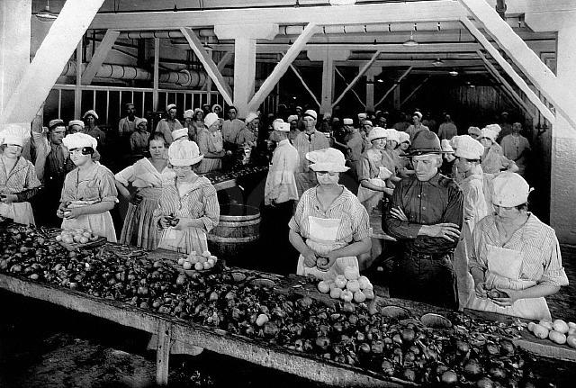
Solution:
Women replaced men in factories.

Slide 17
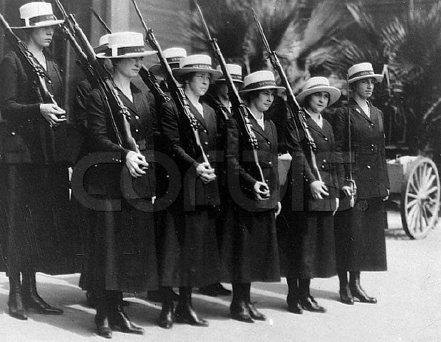
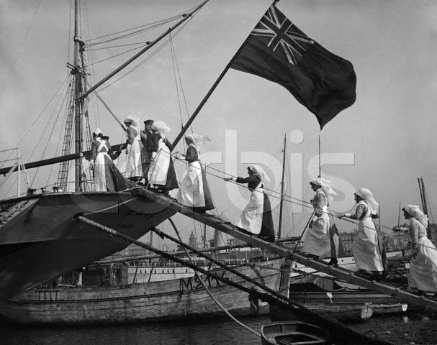
Role of Women in the war:
US Navy Yeomanettes
Nurses from all nations

Slide 18
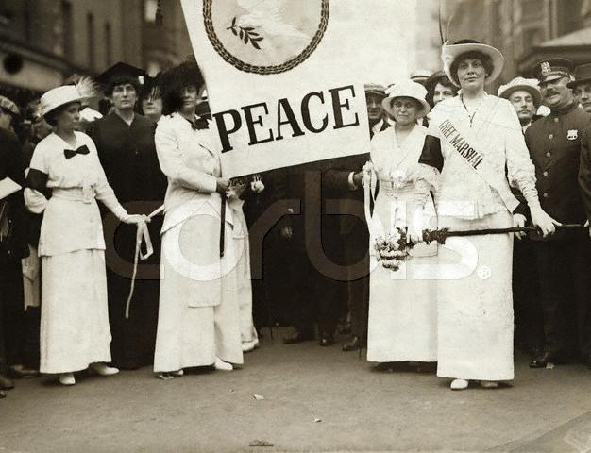
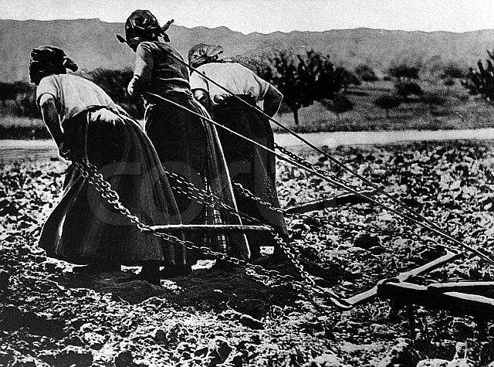
Role of Women at home:
Demonstrating for peace
French women working in the fields-all horses eaten or at war!

Slide 19
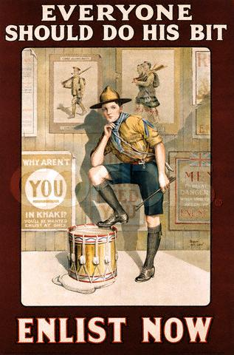
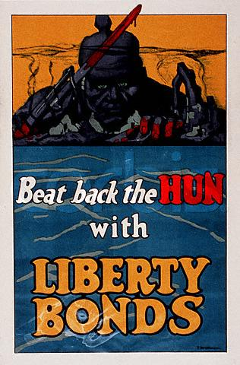
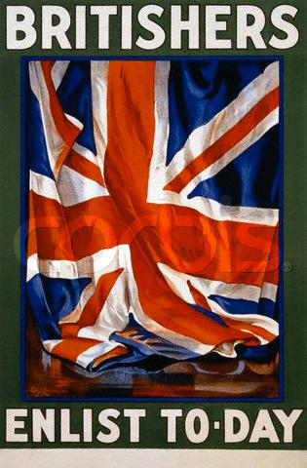
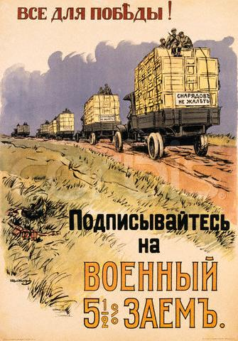
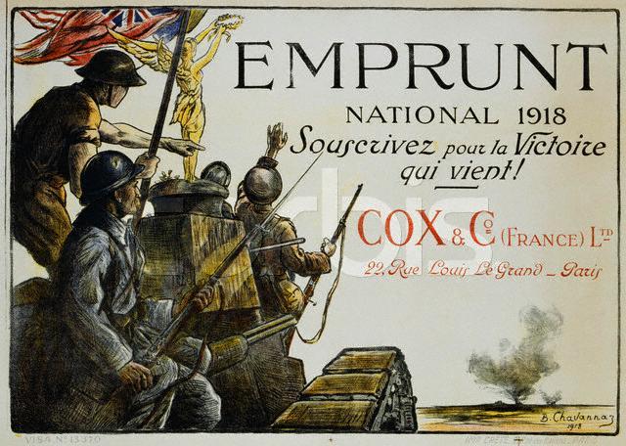
Propaganda
Governments on both sides used propaganda to inspire and to convince people to support the war.

Slide 20
The end of the war
Armistice day:
11th hour of the
11th day of the
11th month
1918

Slide 21
Wilson’s 14 Points A Proposal for Peace
Freedom of the seas
Freedom of trade
End to secret alliances
Right to self-rule for all nations
Settle colonial claims
Establish a general assembly of nations

Slide 22
The Peace Treaty Treaty of Versailles
Harsh terms of the treaty dictated by the winners
Wilson’s 14 Points
Punished Germany-reduced army, seized territory, stripped colonies, forced to pay reparations
Created new countries from Austria-Hungary, the Balkans and the Ottoman Empire

Slide 23
Aftermath of the War
Devastated countries-roads, factories, farms bombed out craters
9 million soldiers dead
21 million injured
13 million civilians dead

Slide 24
Long Term Results
Germany and Italy harbored great resentment over the harsh terms of the peace treaty
United States retreated into a policy of isolationism
Entire generation lost innocence and their lives
Europe war-torn, economy and infrastructure destroyed.
Political conditions ripe for the rise of fascism

Slide 25
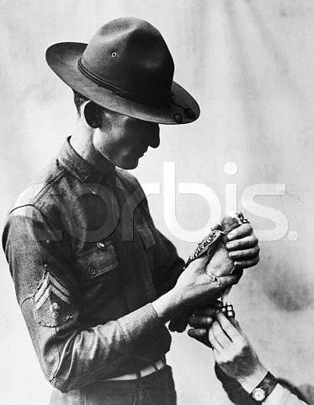

Slide 26
Watch the League of Nations video and answer the following questions: https://www.youtube.com/watch?v=r0ldr18Rnho
Why was the League of Nations considered Wilson’s biggest success and biggest failure?
What was the purpose of the League?
Why did the US not join?
Why did the League eventually fail?

