Slide 1
US IMPERIALISM & THE SPANISH AMERICAN WAR

Slide 2
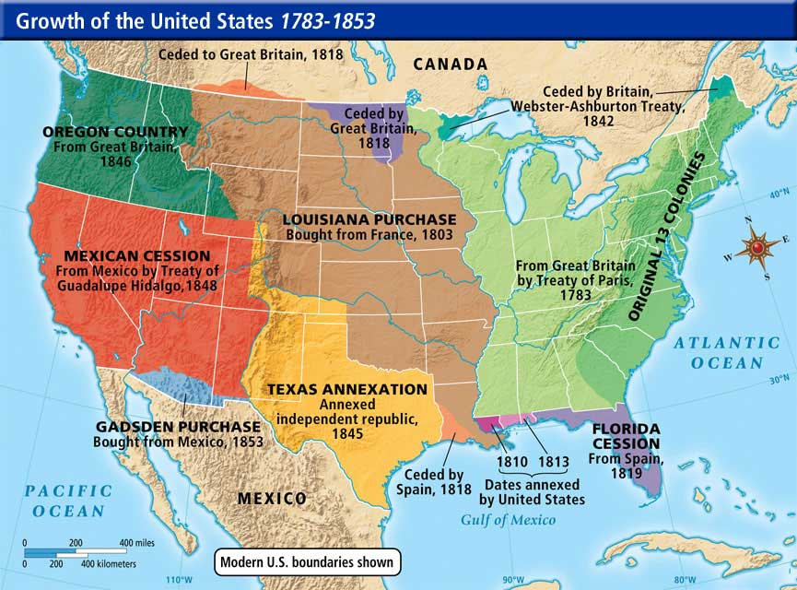

Slide 3
Slide A – US Expansionism in the 1800s
Manifest Destiny – The belief that Americans were a superior people and had the right to control the North American continent.
This belief “came true” when the 1890 census bureau announced there was no more frontier.
Expansionism – US economy expands with foreign trade
Imperialism – 1. belief that US must sell its products to foreign markets if it wants to be strong in the modern world 2. The US would need to protect these foreign interests with an enlarged and powerful navy that would require colonies for overseas naval bases. 3. Some saw it as US obligation to spread democratic & Christian values to people in other lands.
Anti-imperialists – do not believe trade should lead to domination of one nation…leads to fierce foreign policy debates.

Slide 4
Slide B – Revolution in Cuba
Cuba owned by Spain…Cubans seek independence but Spain rules repressively
US identifies with Cuba (we fought for independence) AND sees $$ in sugar plantations there.
Jose Marti plans Cuban revolution and launches it from US…a fierce, destructive war results
US supports Cuba, but wants to avoid war with Spain…Spain promises reforms in Cuba.

Slide 5
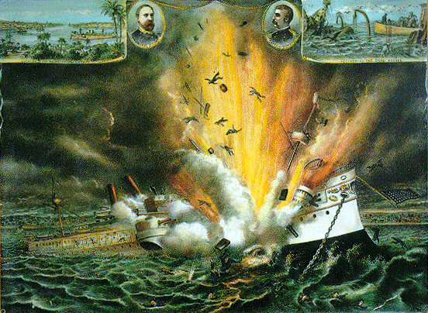

Slide 6
Slide C – The Maine Incident
Spanish troops in Havana will not allow reforms to be implemented
USS Maine sent to Havana Harbor to protect American citizens and property & show concern over crisis
Feb. 15, 1898 – explosion on Maine kills 260 American officers and crew
Most Americans blame Spain even with no evidence
“Remember the Maine! To War with Spain!”

Slide 7
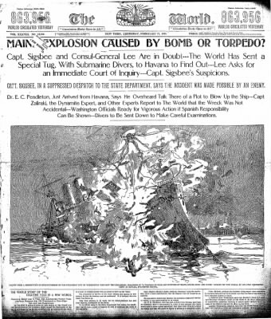

Slide 8
Slide D – Yellow Journalism
sensational headlines and stories, with little attention to facts, designed to grab the attention and stir up the emotions of readers.
Journalists sometimes fabricate stories to feed on anti-Spanish sentiment in the country and push US to War.
Pres. McKinley still tries to negotiate with Spain, but Cubans are given no say…so he finally gives in to political & public pressure and asks Congress to declare war on Spain (April 1898)

Slide 9
“The Editor’s to Blame” - written in 1890’s
Answer the following:
What event(s) does this song refer to? How do you know?
Who is/are the editors that the singer blames? How could they be blamed for what happened?
Do you think the editors are the only ones to blame? Why or why not?
Do you think what the singer says in the first verse of the song is generally true? Explain and give an example.

Slide 10
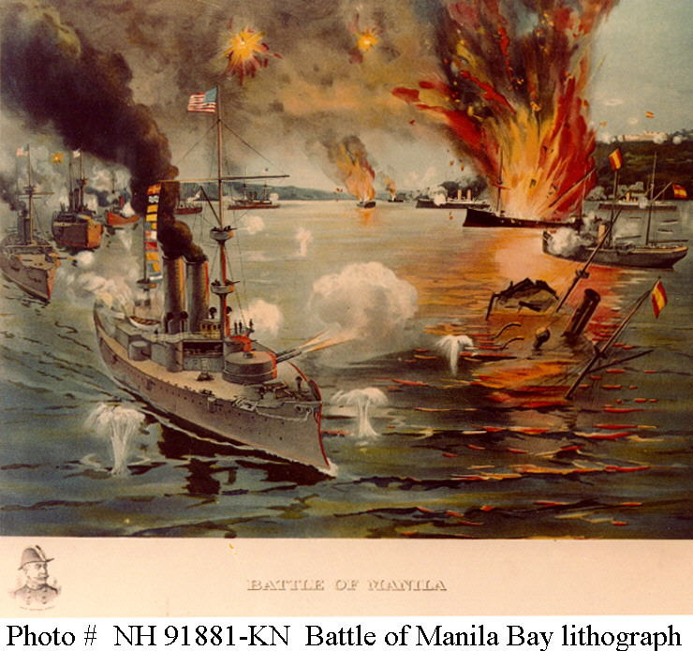

Slide 11
The Spanish American War
War actually begins in the Spanish colony of the Philippines…US Navy sinks all ten Spanish ships stationed there.
US waits for ground troops and ousts Spanish rule from all territories except Manila. Captures Manila with the help of Filipino rebel Emilio Aguinaldo (he hoped US would give Philippines its independence)
War moves to Cuba – June 20, 1898 fighting in island begins and includes African Americans anxious to bring freedom to Cuba

Slide 12
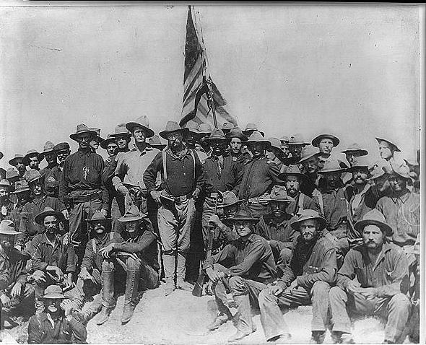

Slide 13
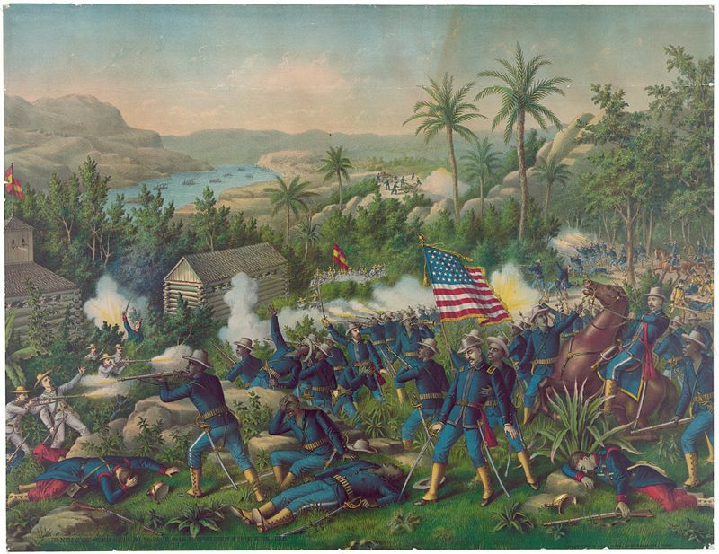

Slide 14
Spanish American War (cont.)
“Rough Riders” – a group of volunteer soldiers led by Theodore Roosevelt (cowboys, college students, ex-polo players, & other adventurous types.)
Not the best fighters, but they embodied American enthusiasm and the press loved them.
US defeats Spain – 1st major battle in Cuba turned out to be the last...Spanish fleet tries to flee and is destroyed by US Navy
US goes on to easily conquer Spanish held island of Puerto Rico
War’s toll on soldiers – 385 Americans killed in action, but another 5000 died of tropical diseases and bad food (supplied by Army)
Treatment of African Americans
– not given much acclaim
- Whites in the South resented the status for African Americans that accompanied their military uniforms
- Many Americans did not accept the fact that a united free Cuba might help erase color boundaries in the US

Slide 15
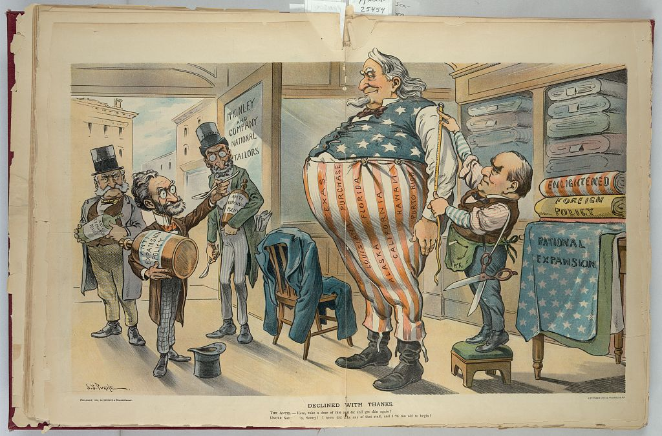

Slide 16
Slide H – The US Emerges as an Imperialist power
Treaty of Paris ends War – Cuba gains independence and US gains Puerto Rico, Guam & the Philippines…10 million people added to “American Empire”
US Still influences Cuba and establishes naval stations on the island
US rules the Philippines claiming they were “unfit for self government”
US has expanded its role and influence over Asia
Anti-imperialists wonder how US can uphold its principles in the DOI and Constitution

Slide 17
Slide I – US Imperialism in the Early 1900s
Roosevelt’s “Big Stick” policy –
Taft’s “Dollar Diplomacy” –
Wilson’s “Moral Diplomacy” -

