Slide 1
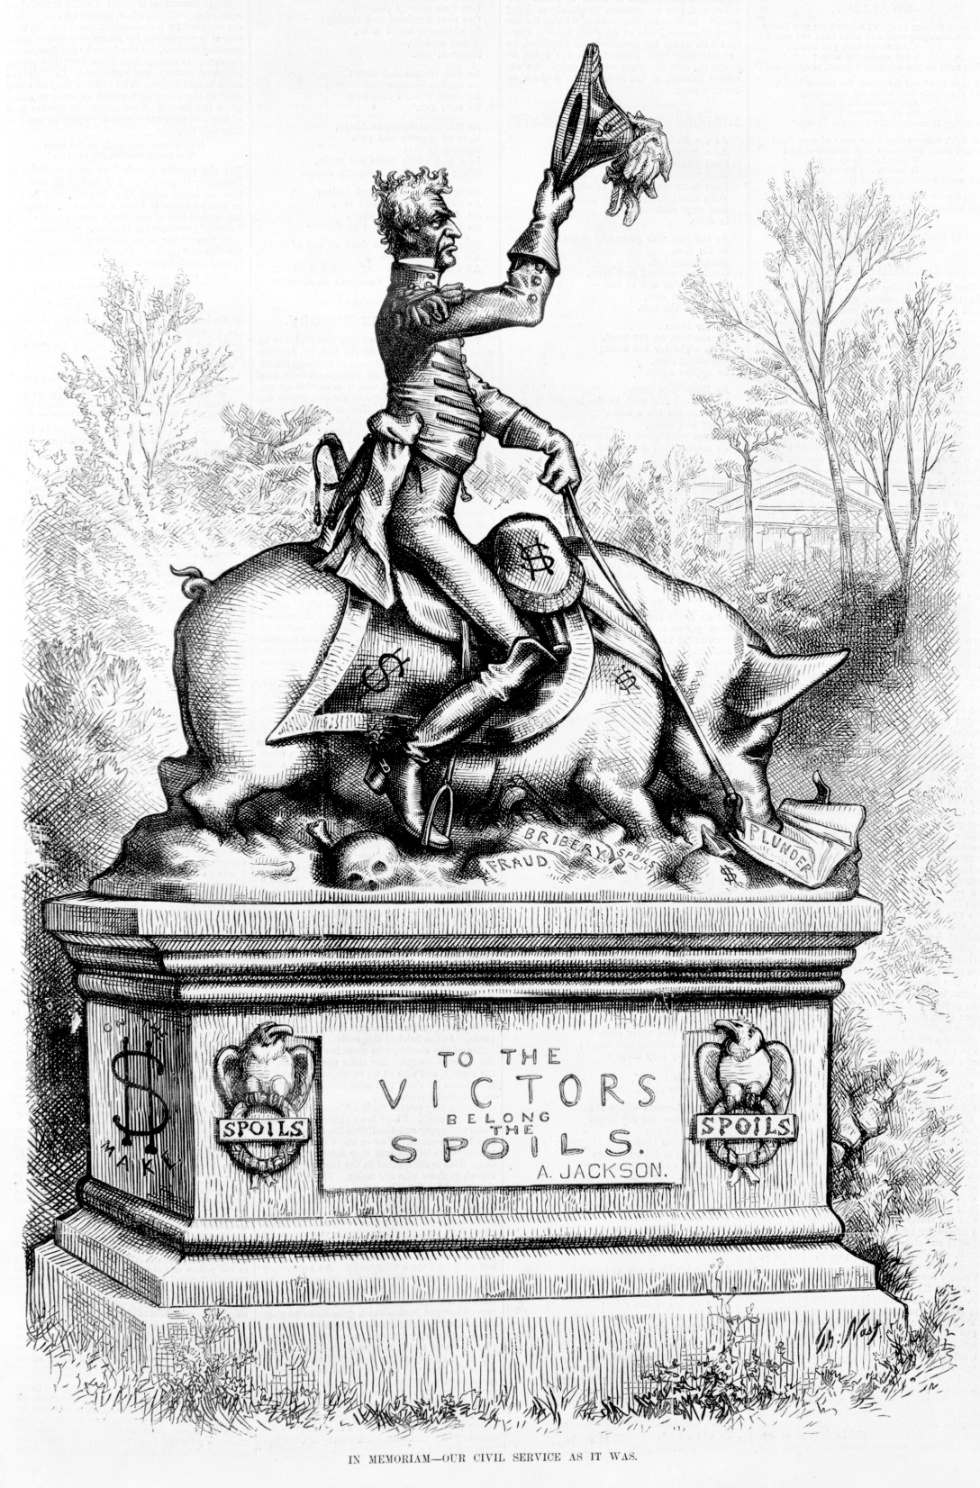
The Spoils System
Upon assuming the Presidency, Jackson fired over 200 government workers and replaced them with his own Democratic supporters.
A supporter of Jackson’s replied to criticism of the president by stating, “To the victor belong the spoils.”
Spoils system – practice of rewarding supporters with government jobs

Slide 2
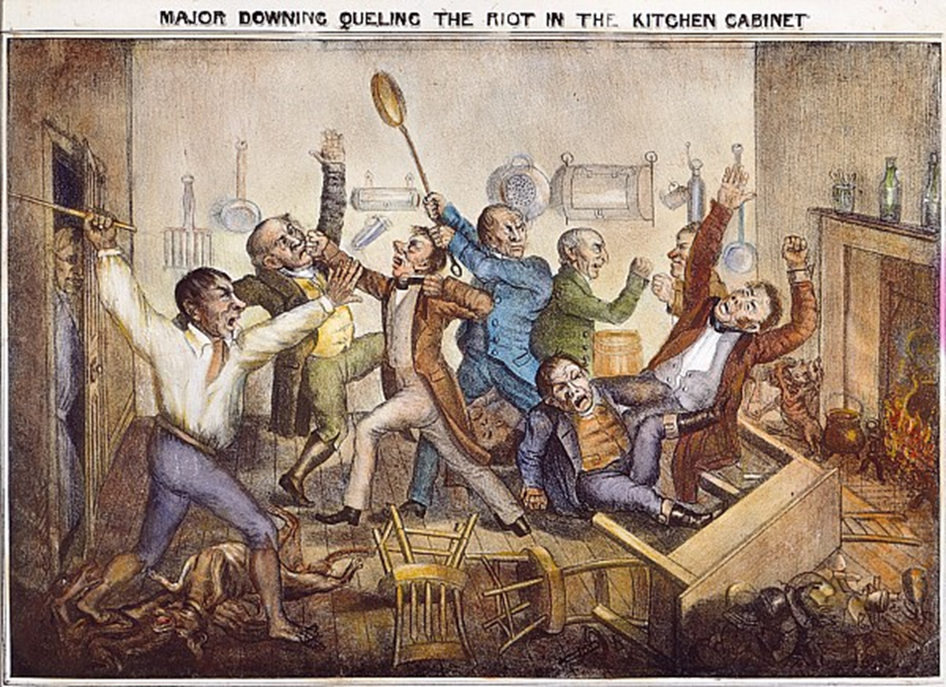
Jackson appointed some of his most dedicated supporters with jobs within his Cabinet, although few of them were qualified for the job.
Instead of relying on his Cabinet for advice, Jackson relied on a small group of unofficial advisors known as the “kitchen cabinet”
since Jackson frequently met with them in the White House kitchen.

Slide 3
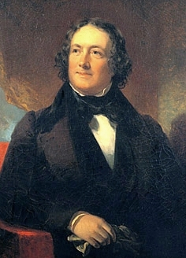
The Bank War
Jackson believed that the Bank of the United States had too much power and served the needs of the rich over those of average Americans.
For example, the Bank of the United States had the ability to limit the amount of money state banks were allowed to lend to small business owners such as farmers and merchants.
Jackson felt particular anger towards the bank’s president, Nicolas Biddle.

Slide 4
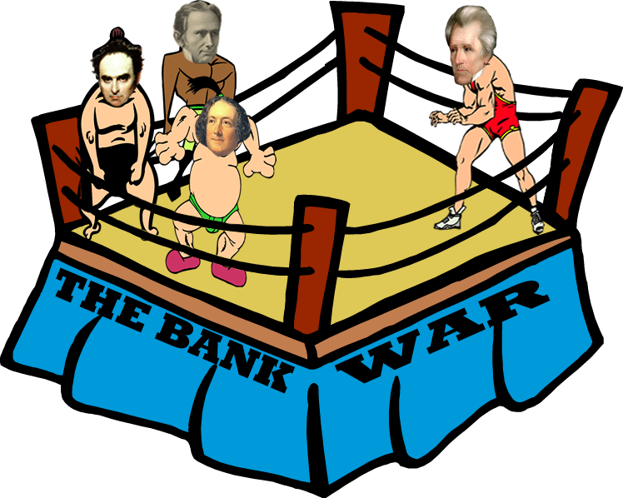
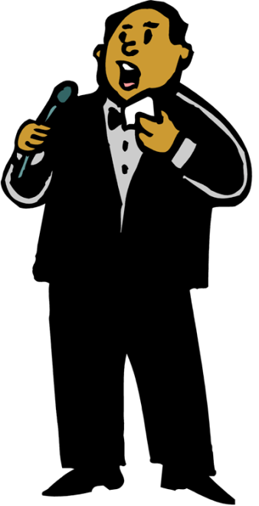
Henry Clay
Daniel Webster
Nicholas
Biddle
In the corner to my right, coming in with a combined total of 500 pounds, are…
and Nicholas Biddle!
Welcome, ladies and gentlemen, to THE BANK WAR!
Henry Clay…
Daniel Webster…

Slide 5
Henry Clay
Andrew Jackson
Daniel Webster
Nicholas
Biddle
HEY! Introduce me already or I’ll fight you, too!
and “King Andrew” to his detractors.
And, in the corner to my left, the man known as “Sharp Knife” to the Creeks…
“Old Hickory” to his admirers…
Coming in at a lean, mean 155 pounds, may I introduce to you…
the man who inspired the Democratic donkey…
No, that’s okay. Introducing President Andrew Jackson!
the pride of the common man…
the man who…

Slide 6
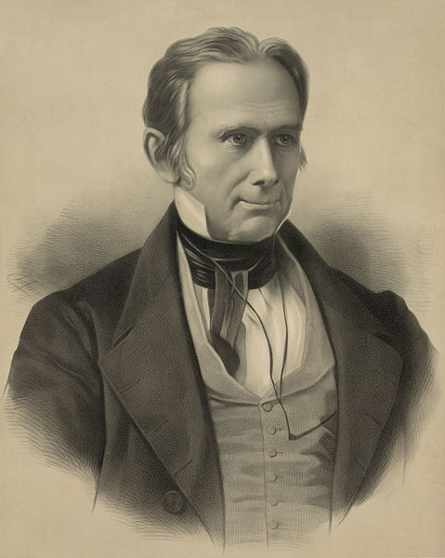
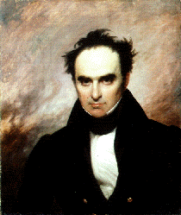
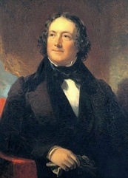
Henry Clay and Daniel Webster, political enemies of Jackson, devised a plan to exploit Jackson’s hatred of the Bank of the United States to help weaken him before the 1832 presidential election.
Hey, Daniel, I’ve got a plan that’s certain to hurt Jackson in 1832 and finally bring the Whig party into power!
Hello, gentlemen. I came as quickly as I could!
Well, first we need to get the president of the Bank of the United States, Nicholas Biddle in here. He’ll help us. He and Jackson hate each other!
Okay, what have you got?
Henry Clay
Daniel Webster
Nicholas Biddle

Slide 7
Clay and Webster convinced Nicholas Biddle to submit his application to renew the charter for the Bank of the United States earlier than required.
Yes, thank you for coming. Mr. Biddle, I would like you to submit an application to renew the charter for the Bank of the United States.
Yeah, the current charter isn’t even set to expire soon!
What would that prove?
Henry Clay
Daniel Webster
Nicholas Biddle

Slide 8
I don’t know. Veto it?
Don’t be so short sighted! What do you think Jackson will do when you apply to renew the charter?
I’m sure that’s exactly what he’ll do.
Henry Clay
Daniel Webster
Nicholas Biddle

Slide 9
Clay, Webster and Biddle predicted that Jackson would veto the charter application, angering so many Americans that he would eventually lose his bid for reelection in 1832.
Precisely! The American people will be furious with him. He’ll never win reelection in 1832! (By the way, did I mention that I’m going to run for president in 1832?)
Brilliant!!
By golly, I think it’ll work!!
Henry Clay
Daniel Webster
Nicholas Biddle

Slide 10
Henry Clay
Andrew Jackson
Daniel Webster
VETO!
Yes! He fell for it!
BANK CHARTER
Nicholas
Biddle
Oh, really? Fat chance! Bring it on, Clay!
Yes! The people will be furious and Jackson will never win reelection! Ha ha ha ha….(evil laugh)
Oh, Mr. President! Here’s the application to renew the charter for the Bank of the United States!
Fools! You know very well that I will never accept this! So, let me make sure not to disappoint you!

