Slide 1
Industrialization Notes

Slide 2
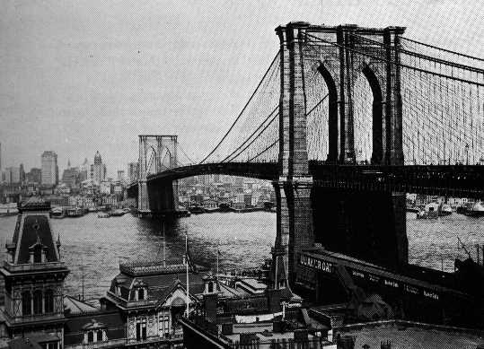

Slide 3
Slide A – Brooklyn Bridge
Longest suspension bridge in the world in 1883
Symbol of America’s transition to an industrial nation
Manufacturing most common in Northeast & Midwest, but starting to grow in South
Impact of industry is uneven on people

Slide 4
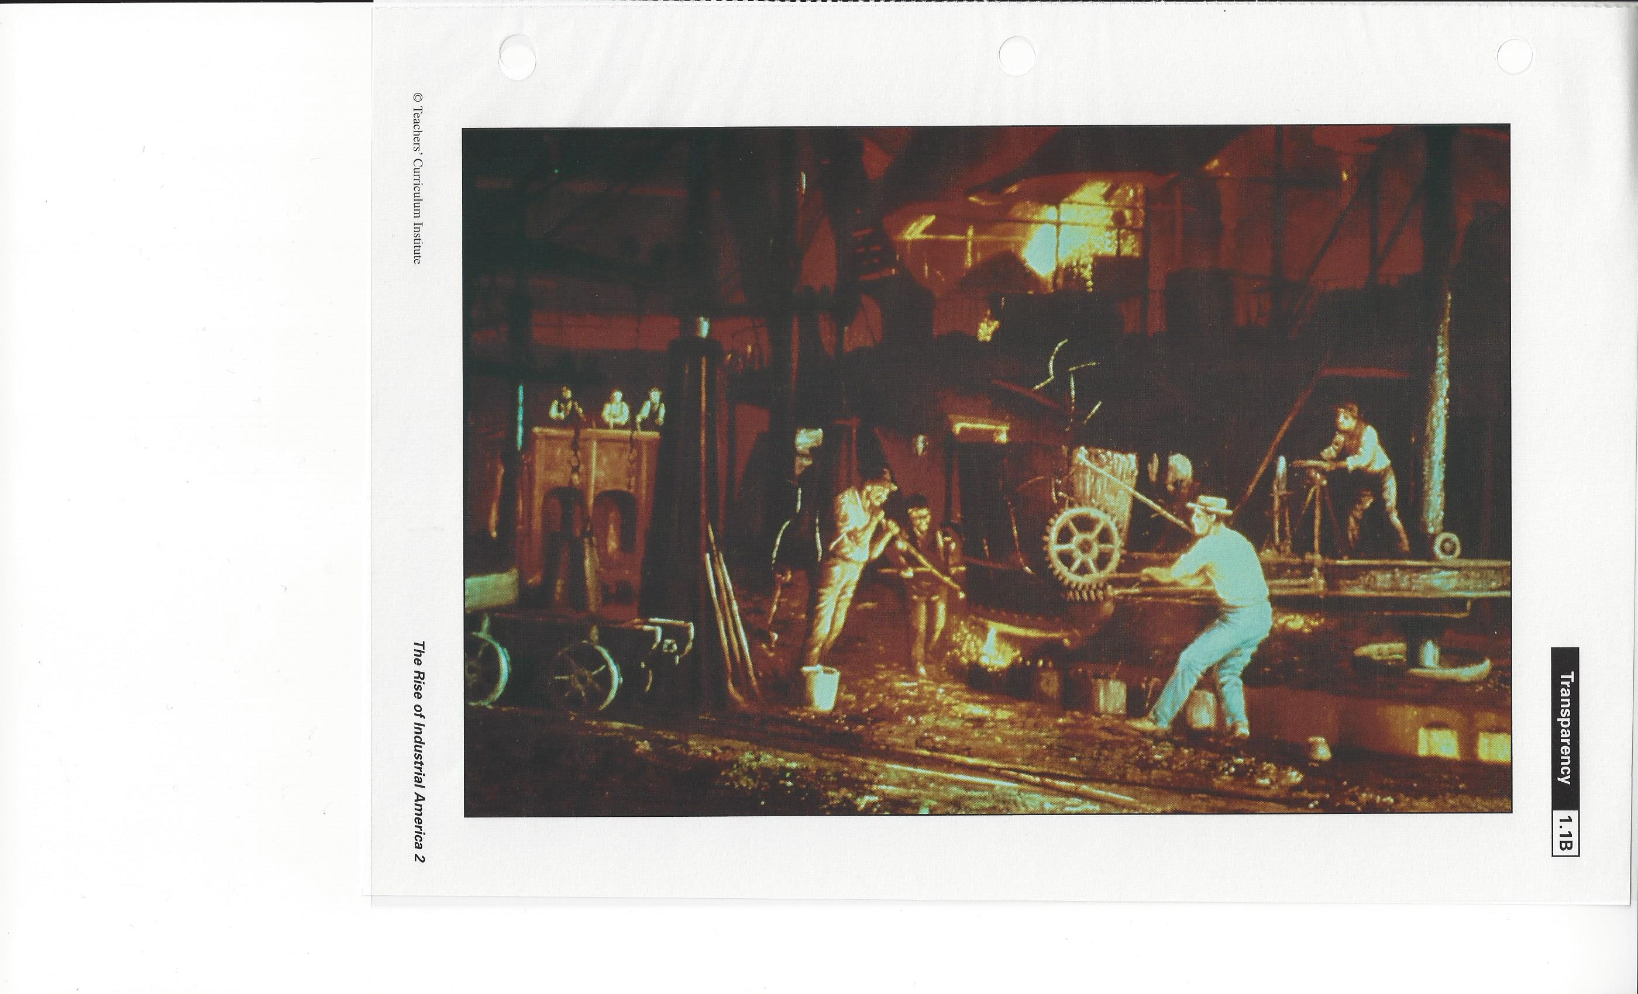

Slide 5
Slide B – STEEL INDUSTRY
Bessemer process - large quantities of steel could be made cheaply & quickly (The key principle is removal of impurities from the iron by oxidation with air being blown through the molten iron. The oxidation also raises the temperature of the iron mass and keeps it molten.)
Steel production increases from 2000 tons in 1867 to over 7 million tons on 1900
Steel is stronger & more durable than iron – more tech advances like train tracks, girders for skyscrapers, beams & cables, etc.

Slide 6
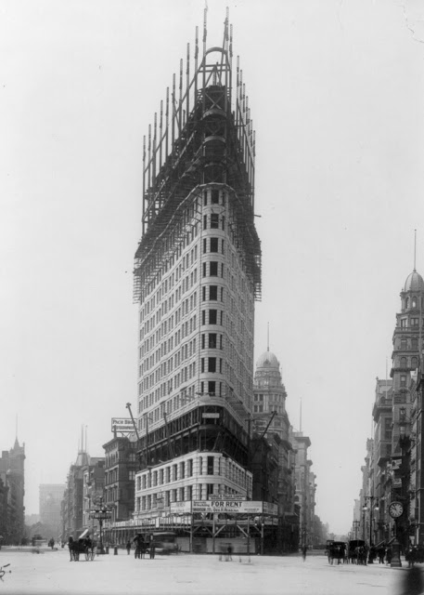

Slide 7
Slide C – Skyscraper http://nyc-architecture.com/GRP/GRP024.htm
Only steel girders could support this…steel industry fuels construction industry
CITIES GROWING QUICKLY – SPACE IS A COMMODITY – SO WHERE DO
YOU BUILD?
UP!

Slide 8
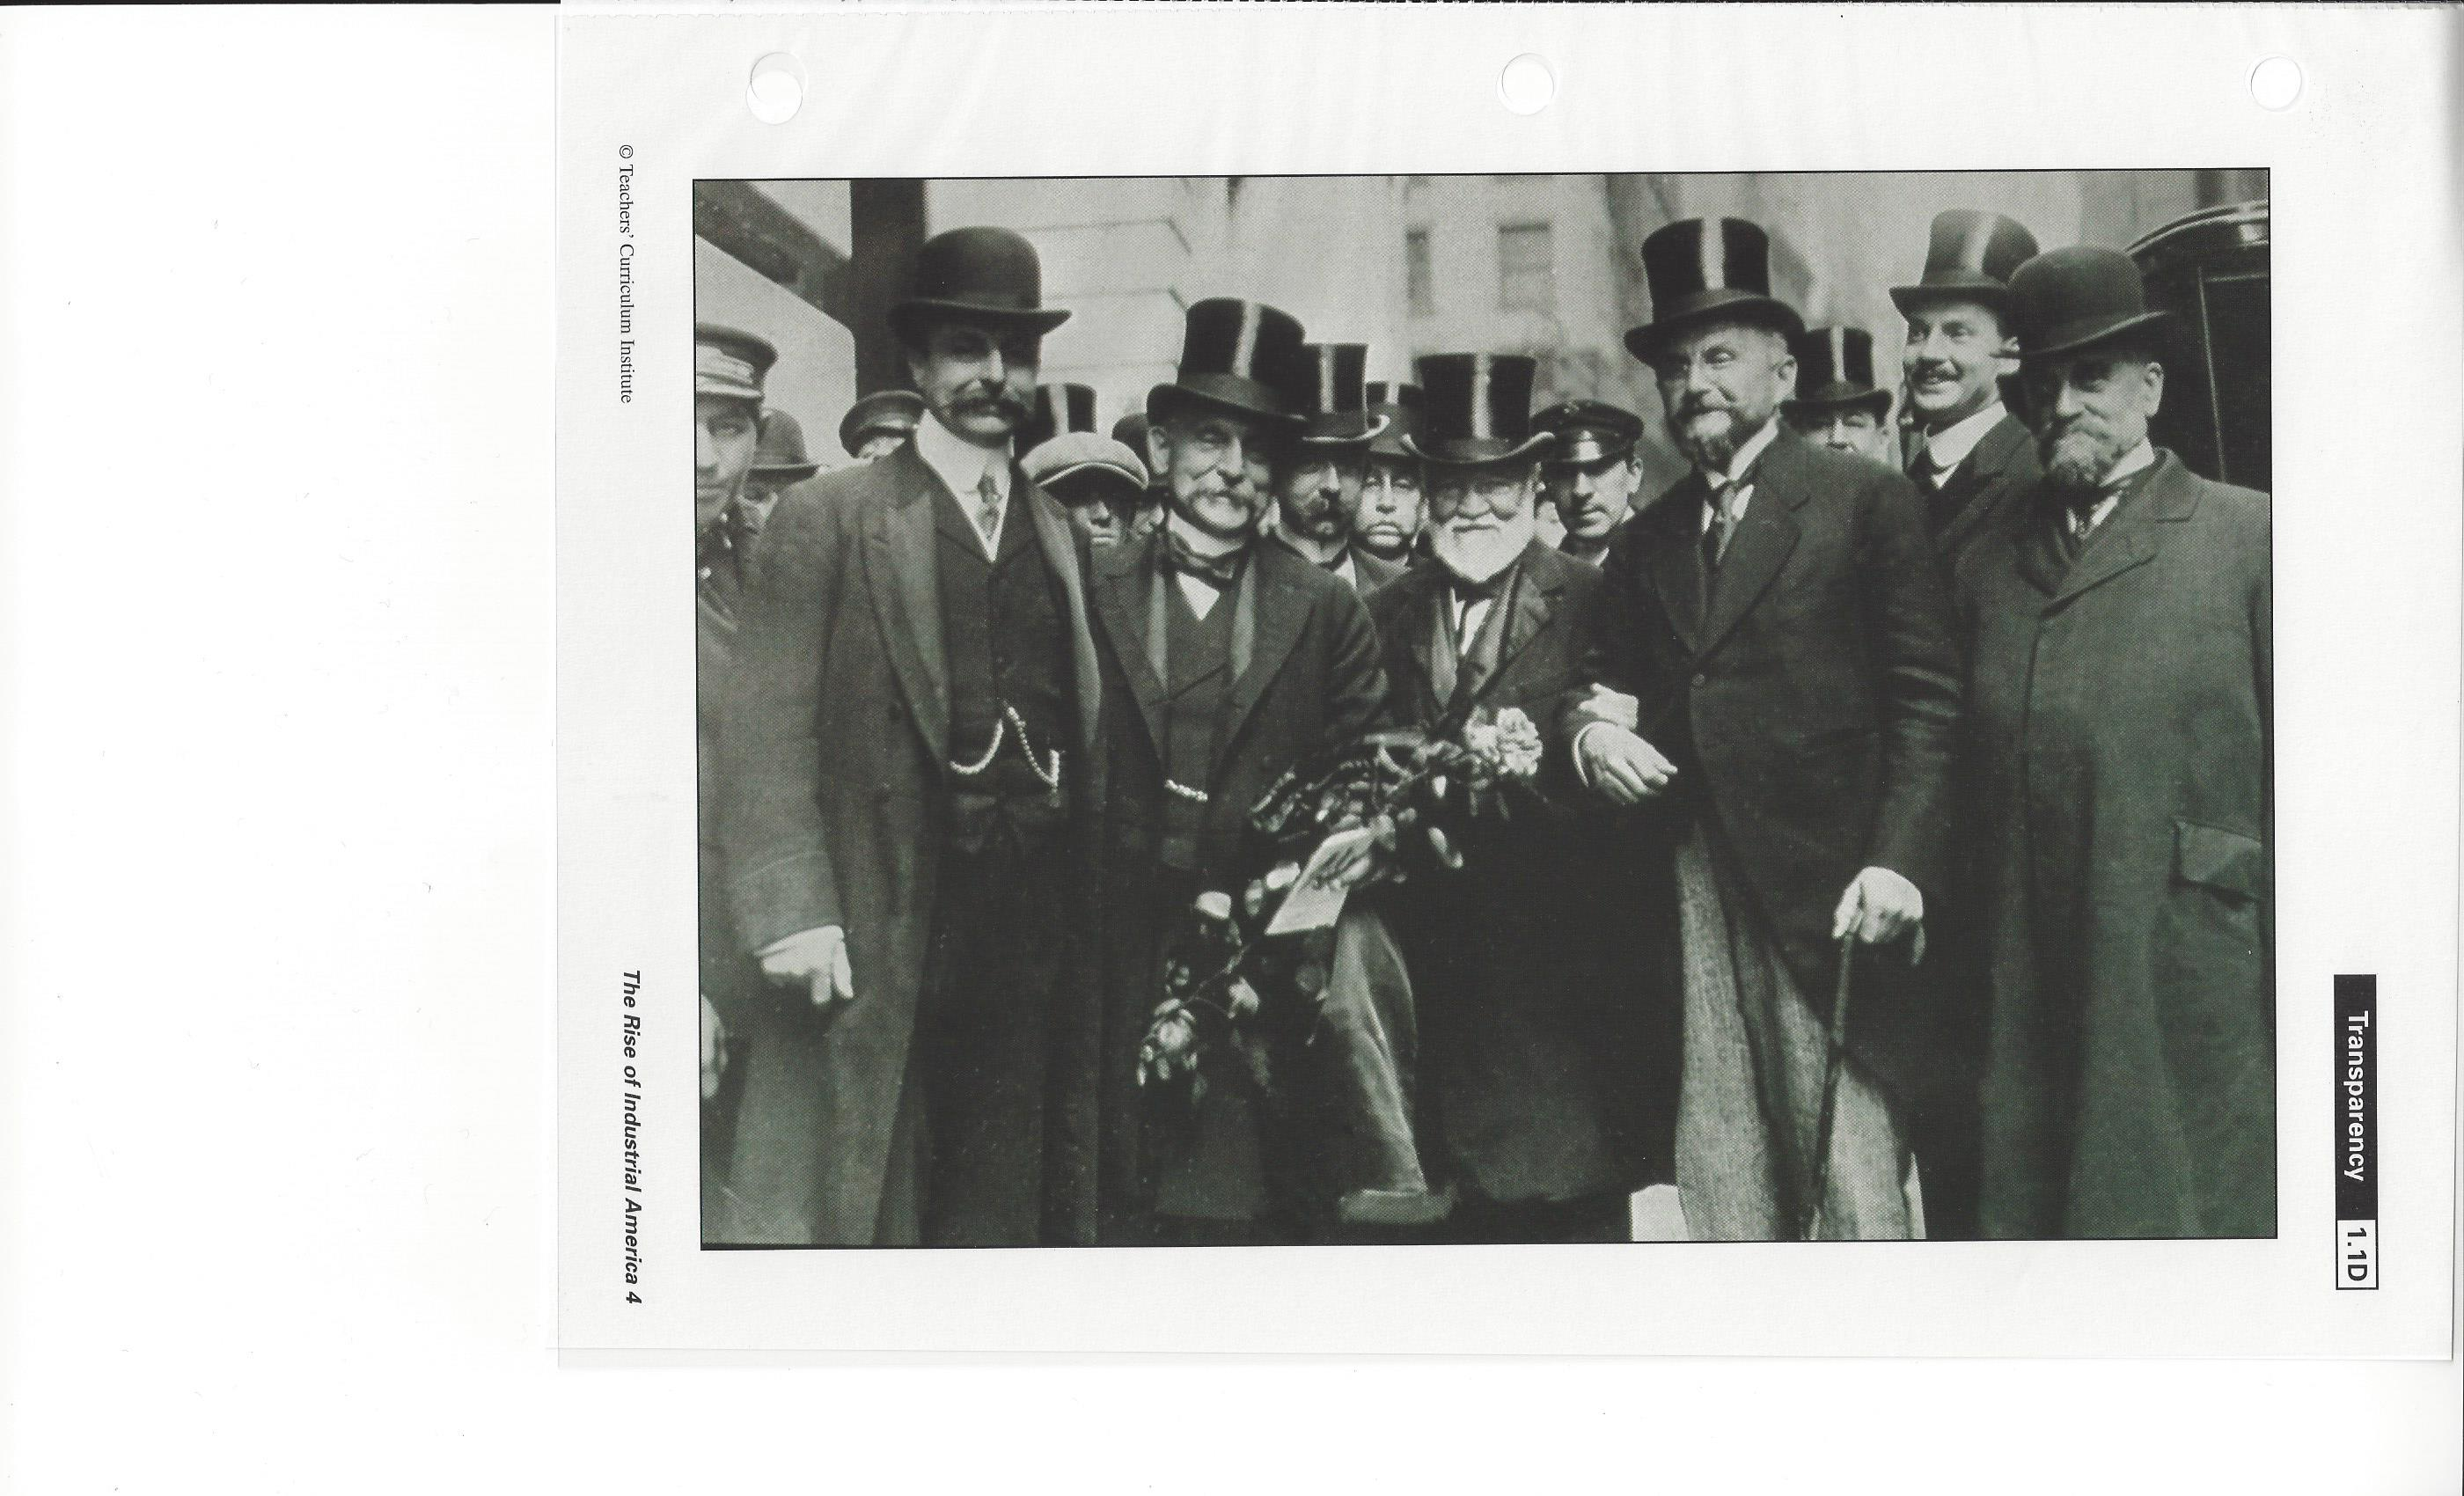

Slide 9
Slide D – Andrew Carnegie
One of America’s wealthiest & most famous business leaders
Made his millions through control of the steel industry
By 1900, over 4000 millionaires in the US compared with only a few before the Civil War
Carnegie believed the wealthy had a right to make money but also a responsibility to spend money properly
“A millionaire should be a trustee for his poorer brethren, bringing to their service his superior wisdom, experience, and ability to administer, doing for them better than they would or could do for themselves.”

Slide 10
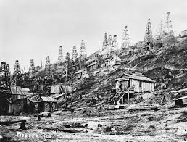

Slide 11
Slide E – Oil
Industrialists rush to exploit Pennsylvania’s oil reserves
Oil refining becomes big business when automobiles, locomotives, and turbines are replacing steam & horse powered machines.

Slide 12
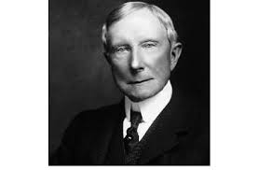

Slide 13
Slide F – John D. Rockefeller – Standard Oil
Rockefeller starts taking over oil business by buying up refineries (he knows the oil is useless until it is refined)
Uses ruthless methods to eliminate competition…lowers his prices to woo competitor’s customers away, competitor goes out of business, then he raises prices
Eventually Standard Oil has a virtual monopoly of the oil industry
Monopoly – no competition

Slide 15
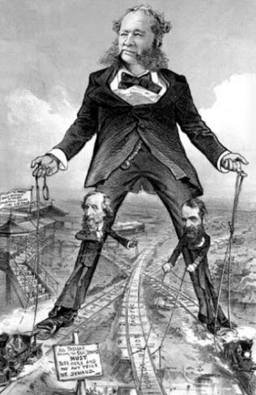

Slide 16
Slides G & H– Railroads & Vanderbilt
Transportation is the key to industrialization
After the Civil War. Most track is still in the East…most not connected
Vanderbilt begins to expand and connect rail network by buying up lines between NY & Chicago
Consolidating lines leads to faster & inexpensive shipping

Slide 17
Thoughts…
Did men like Carnegie, Rockefeller & Vanderbilt cause more harm than good? Some claim they ruthlessly drove small companies out of business, exploited their workers, cut corners on quality, and “bought off” government officials. Moreover, it is argued that the big monopolies they created overcharged for goods because of lack of competition, and that they polluted the environment and wasted natural resources.
Others argue industrialization could not have occurred without men willing to gamble, as Carnegie, Rockefeller, and Vanderbilt did. They are praised for their philanthropy. And, many argue, the big corporations such as Standard Oil and Carnegie Steel invented or perfected many technologies that inevitably lowered the cost of products and improved the quality of life for millions of Americans
Was anyone involved in Florida?

Slide 18
US History Industrialization writing assignment
Answer the following in a one page essay:
Were these leaders of American business “Captains of Industry” or “Robber Barons?” Select one of the following entrepreneurs:
J.P. Morgan
John D. Rockefeller
Andrew Carnegie
Henry Flagler
Cornelius Vanderbilt
Use your book, your notes and the internet to conduct research in order to answer the question. Whatever answer you choose or topic you develop, it must be supported by evidence (examples that prove your point.)

