Slide 1
Immigration
Late 1800s-Early 1900s

Slide 2
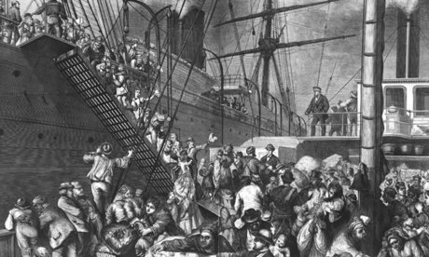
AS you view this slide, turn and talk to your neighbors about the following: - What is happening in the slide? - Who are the people on the boat? - How do you think they are feeling?

Slide 3
Slide A – Reasons for Immigration
- From the end of the Civil War (1865 – 1915) over 13 million immigrants come to the USA.
- Push Factors:
1. War in homeland
2. Famine
3. Religious persecution
4. Overpopulation

Slide 4
Slide B- As you view the slide, turn and talk to your neighbors about the following:
- Who are these people?
- What are some of the hardships of their voyage?
- From what economic class might they come? How can you tell?

Slide 5
Slide C - As you view the slide, turn and talk to your neighbors about the following:
Where is this building located?
If you were an arriving immigrant and this was the first building you saw, what impression would you have of the United States?

Slide 6
Slide D - As you view the slide, turn and talk to your neighbors about the following:
Who are the men with their shirts off?
What is happening in the slide?
How do you think the immigrants feel? Are they receiving fair treatment? Why or why not?

Slide 7
Slides B, C, D, E – The Immigrant Experience
Steerage – The cheapest section of the ship…below decks
- The poorest immigrants traveled here…MANY
- Very diverse group of people crowded in
- this passage/trip could cost one’s life savings
Ellis Island – the main processing point for newly arriving immigrants
- located in New York Bay
- medical examinations – could be a humiliating and dehumanizing experience. Quick exams, lots of questions, could be SENT BACK!
- Inspectors often changed last names as they struggled with foreign spellings and pronunciations.
- Immigrants waited in long lines to be “processed” and have their “fate” decided by inspector

Slide 8
Slide G – As you view the slide , discuss the following with your neighbors:
What are some words you would use to describe this neighborhood?
What are some positive aspects of living here?
What are some negative aspects?
Do you think immigrants had much of a choice about where they lived when they first arrived? Why or why not?

Slide 9
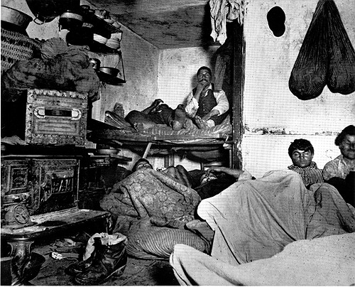
Slide H – Look at the details of the slide…

Slide 10
Slides G & F – The Immigrant Experience in America
1. Immigrants often settled in big cities, especially industrial centers and ports where jobs were available.
- Ethnic neighborhoods were created where residents shared common cultural traits…a “support network”
- BUT…this slowed down the assimilation process
- Living conditions could be crowded & unsanitary

Slide 11
As you view the slide (J), answer the following question in your notebook:
How do you think the European immigrant experience was different than the Asian immigrant experience? List as many differences as you can think of.
Were there any similarities? If so, what were they?

Slide 12
Explain the message of the political cartoon in a few sentences. Is it pro or anti-immigrant?

