Slide 1
Black Power Movement
“The Black Power Movement of the 1960s and 1970s was a political and social movement whose advocates believed in racial pride, self-sufficiency, and equality for all people of Black and African descent.” Odlum, DPLA.

Slide 2
Origins of Black power
1940’s – Phillip Randolph (African American Labor activist) organized March on Washington.
March on Washington - “an all-Negro movement” that would inculcate “a sense of self-reliance” and “break down the slave psychology and inferiority-complex in Negroes which comes and is nourished with Negroes relying on white people for direction and support.” (Khan Academy)
1954 Richard Wright (African American intellectual) wrote “Black Power”. About his trip to Africa’s Gold Coast.
Randolph, Wright and Malcolm X all were aligned in the idea of the need to end white oppression

Slide 3
Malcolm X
Born Malcolm little May 19, 1925 in Omaha, Nebraska.
Converted to Nation of Islam (aka – black muslims) while in prison
fyi: Cassius clay changed his name after converting to Nation of Islam to Muhammad ali (famous heavyweight boxer)
Beleifs founded on teachings of Marcus Garvey (remember him? (back to Africa movement– blacks and whites should be separate)

Slide 4
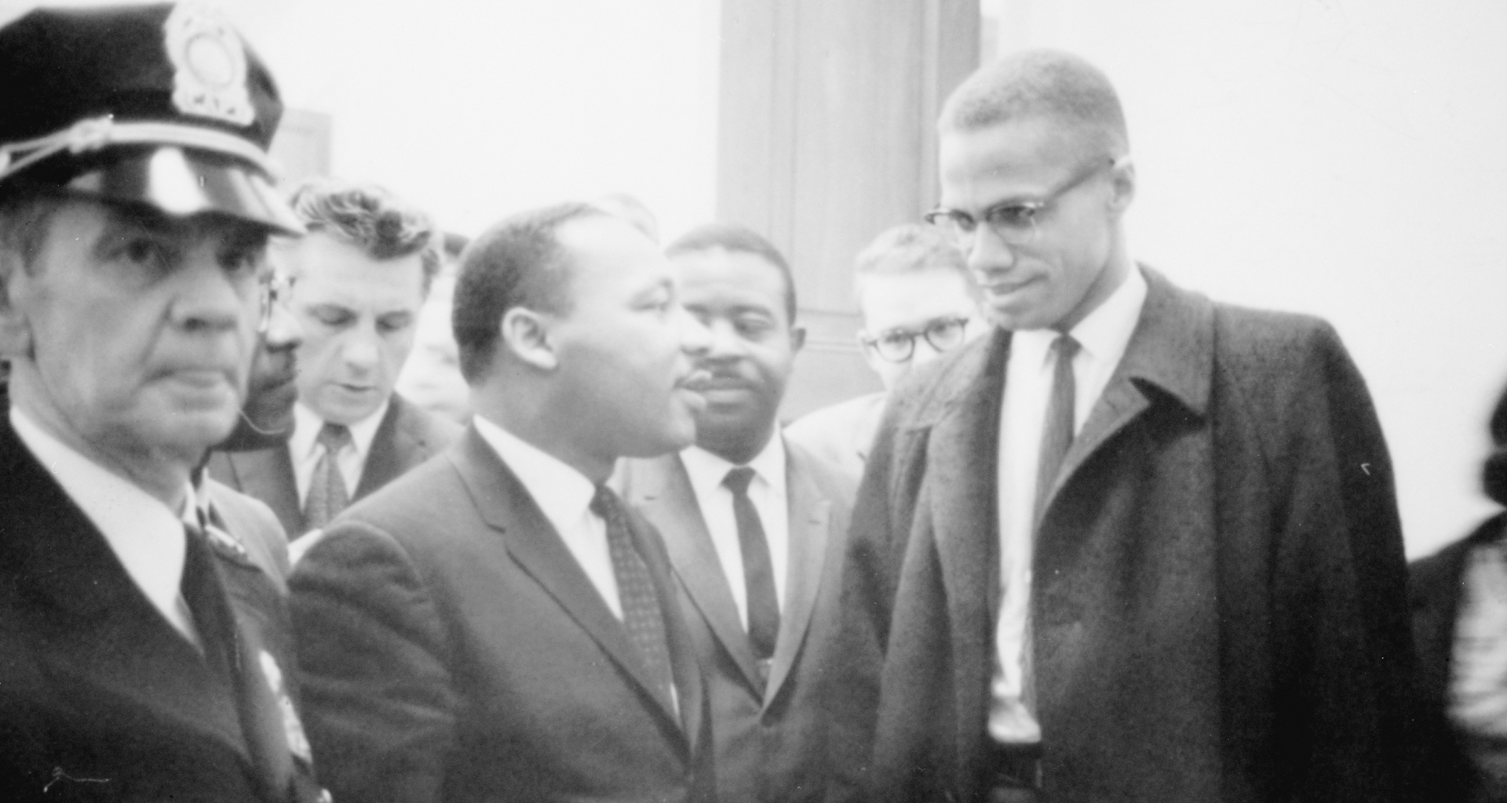
Compare and Contrast MLK/Malcolm X
https://www.youtube.com/watch?v=kq-CBZ5MUHA
FYI: Take notes on similarities and Differences to help with assignment at end of powerpoint.

Slide 5
Support for black power movement
Black panther party: Founded 1966 in Oakland, CA by Bobby seale and Huey P. Newton.
Black Women’s united front
Nation of Islam
Student nonviolent coordinating committee: leader stokely Carmichael (Inspired by Malcolm x)
These organizations sought to expose and destroy white racism through new political, economic, and cultural programs.

Slide 6
Black Panther party
Militant ideology that was created due to address the severe racism and segregation of the time. revolutionary organization with an ideology of black nationalism, socialism, and armed self-defense.
The agenda/platform of BPP can be viewed on this primary source. FYI: read this source to help with assignment at end.
https://dp.la/primary-source-sets/the-black-power-movement/sources/388 (Print or increase the size to help you read it!)
The BPP is known for its opposition of nonviolent methods of dealing with the times.
The black panthers were also seen as community activists and set up programs to :
Provide breakfast for students
sickle-cell anaemia testing
legal aid
adult education.

Slide 7
Assignment
Choose 2 out of the 3 following three choices to complete
create a 1 pager comparing and contrasting martin luther king and Malcolm x. you should add graphics to support your written points.
Read the primary source document (on slide 6) and list five items that you feel were most likely to help the BPP accomplish their goals.
Was the Black power movement a part of the civil rights movement? Explain with evidence why or why not. - 2 paragraphs.

