Slide 1
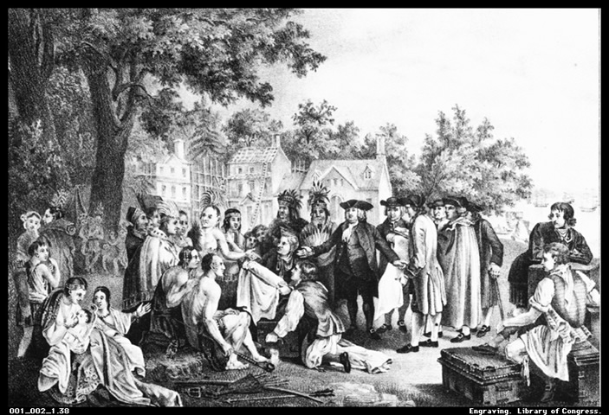
Early US Colonial History

Slide 2
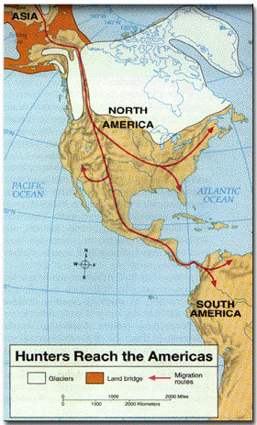
Alaskan Land Bridge (ca 70,000 BCE)
Archaeological evidence has shown that the Ice Age facilitated a “Land Bridge” crossing to the Americas from Asia
Experts postulate Americas were fully populated by ~ 10,000 BCE
# of Native Americans in the Americas at European arrival (1492) ~ 30- 50 million!

Slide 3
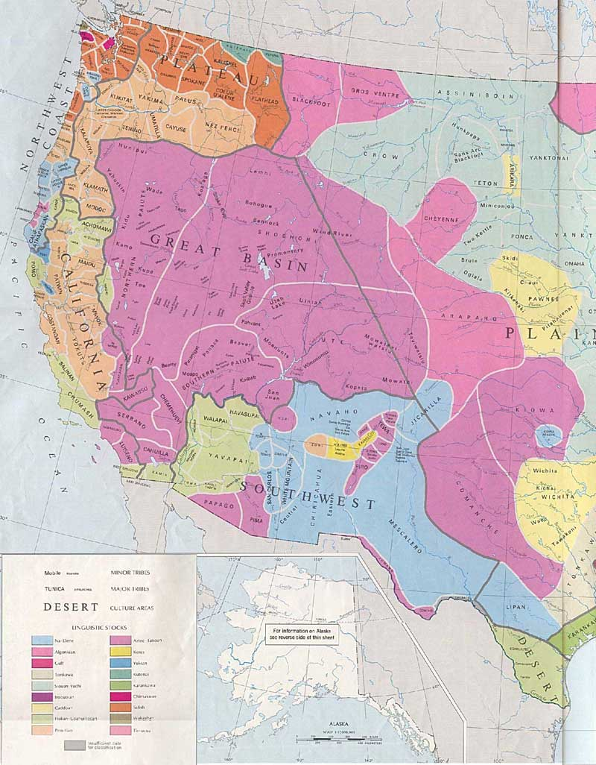
3 “Regional” Native American Populations in US
Southwestern US/Central America – tribes like the Navajo/Pueblo were agricultural & sedentary => Catholic missionaries established 1st contacts
-- Spanish mistreated Native Americans & enslaved them
Great Plains – tribes like the Sioux & Apache were hunters and migratory
-- Did not come into real contact or conflict w/ Europeans until 1800’s
Eastern US – tribes like the Iroquois, Huron & Pequot were primarily trappers, fishers & farmers
-- Came into 1st contact w/ Europeans
Due to the large numbers of cultural/linguistic groups Native Americans were resistant to unification & easy for Europeans to play one group against another

Slide 4
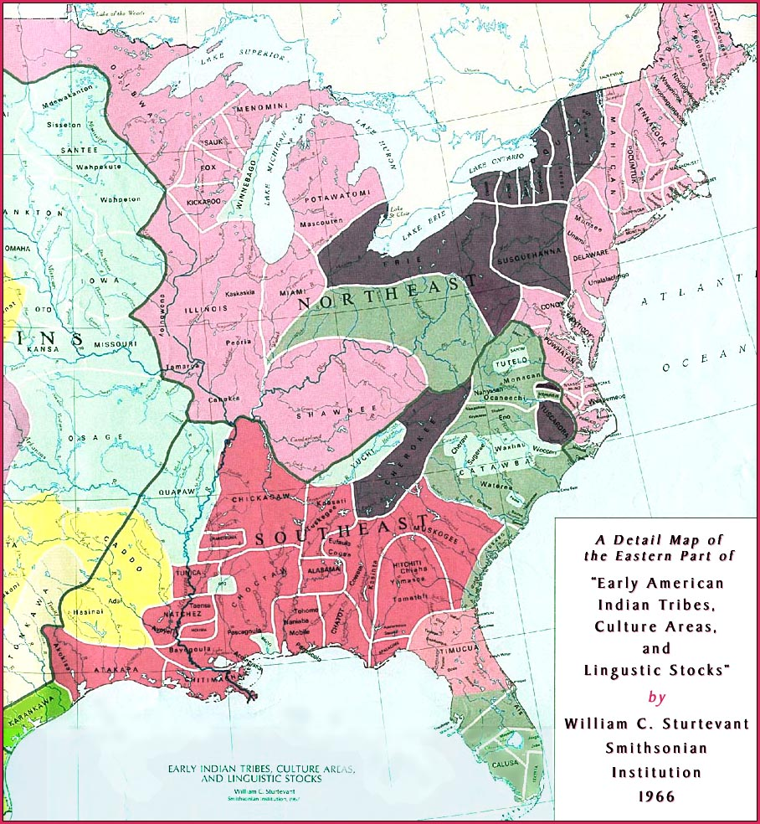

Slide 5
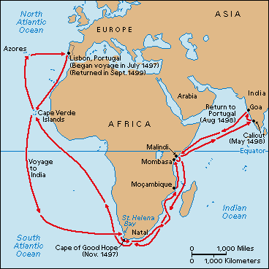
Europeans Search for Trade Routes
Ottoman Empire heavily taxed/controlled overland trade routes to Far East
-- Europeans want a water route (Portuguese already control African route)
Columbus gains permission from Queen/King of Spain to sail west to the “Indies” – makes 1st contact October 12th 1492
-- Not 1st European to set foot on “New World” => Leif Erickson & Vikings had founded a settlement in New Foundland ~1020
** Go Over Columbus book comparison – text vs. Zinn**

Slide 6
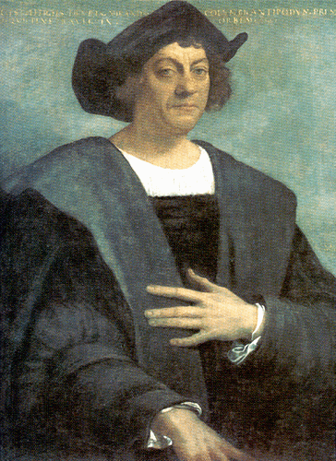
Columbus and European Contact
Spanish are cruel to “Indians” they encounter and force them to mine for gold and serve as slaves
European diseases and brutality kills ~ 90% of the Native population within 75 years of European arrival!
Largest Genocide in world history!
** Why is this not discussed more??**
Images of Native Americans by Early Europeans – What does each picture show? How does it portray Natives? Which is more accurate? Why?

Slide 7
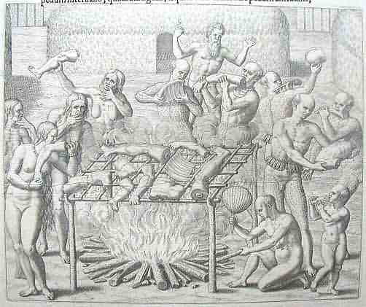
How Tupi Indians Roasted their Meat (ca 1550)

Slide 8
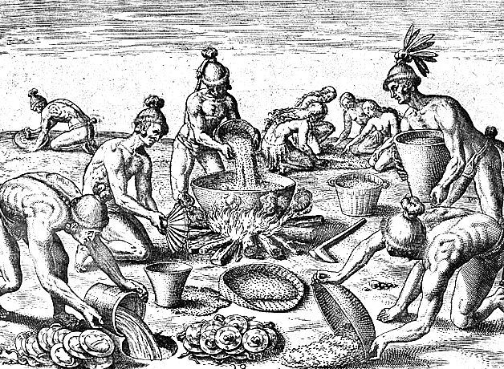
Theodore De Bry – Preparing a Feast (1590)

Slide 9
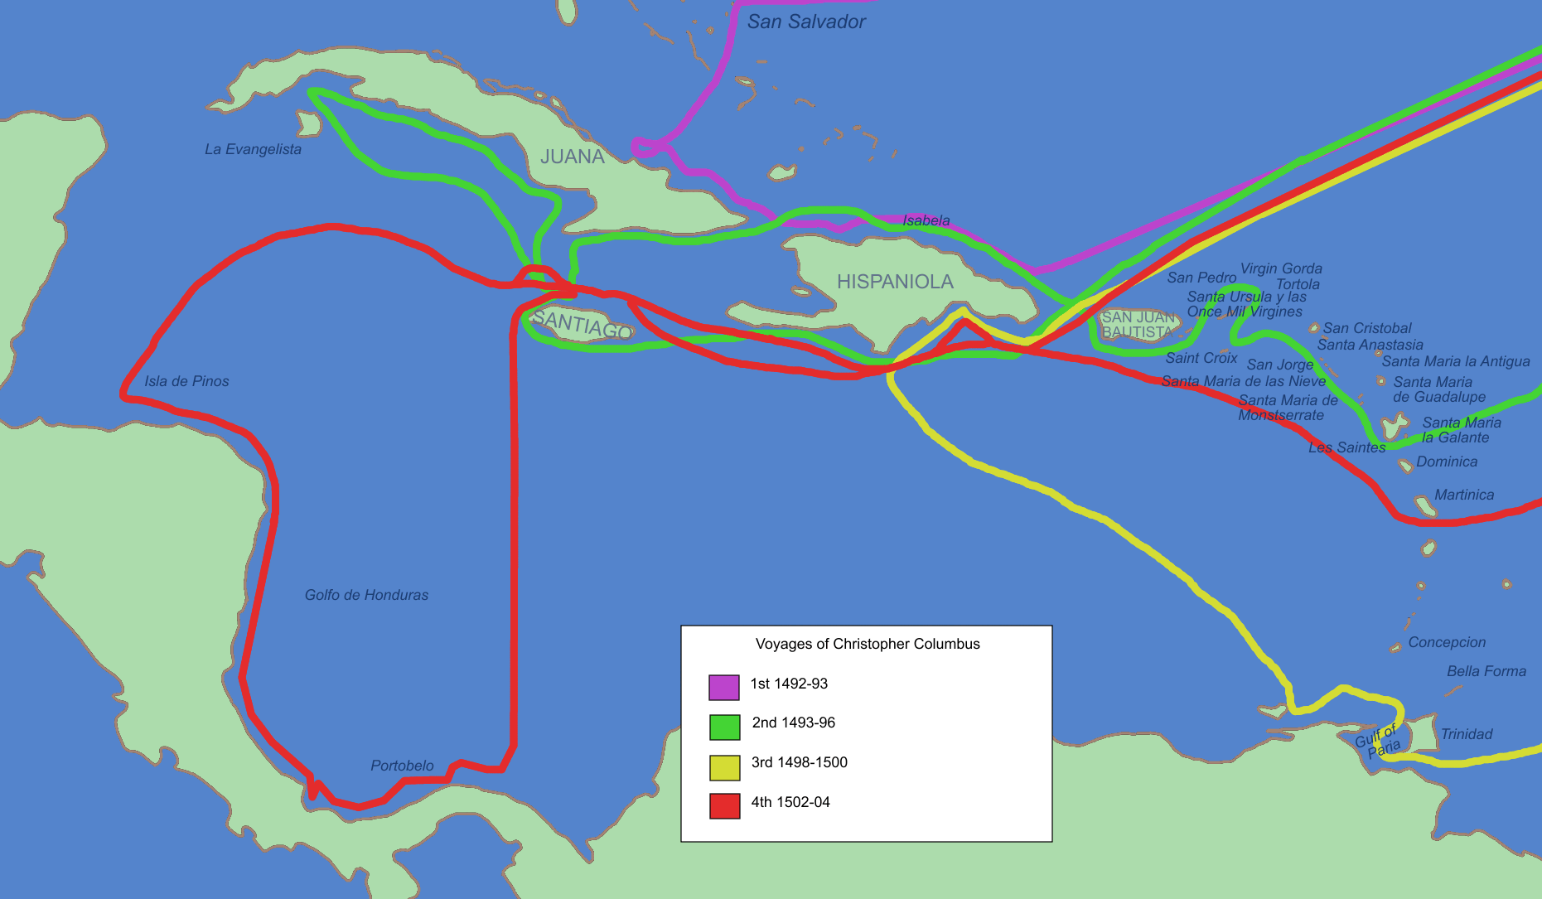
Map of Columbus’s 4 Voyages

Slide 10
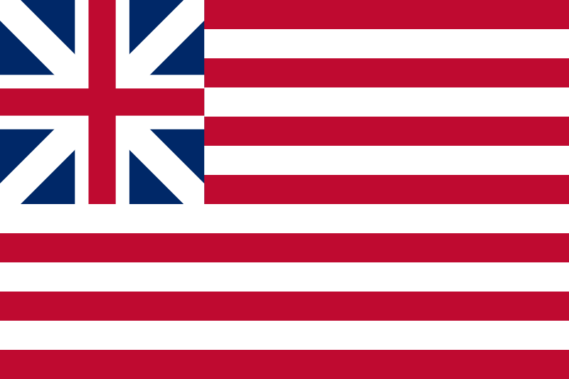
Creating the “American Identity”
What is an American? What “makes” you “American”? How do we define this today and what does it mean for us and our society?
What were Immigrants coming to America looking for/seeking?
#1: NO intentions of developing a new civilization or country
#2: Wanted to escape Religious Persecution – NOT for ‘Freedom of religion’
#3: “Headright System” – each colonists who pays for passage to ‘New World’ receives 50 acre land grant (rich gained massive amount of land by paying for passage of indentured servants) => Land = measure of wealth in Europe
#4: Hoped for a better life economically
#5: Religious enthusiasm led some to brave journey
#6: Desire for change and escape from European society
#7: Some disillusioned w/ European class system

Slide 11
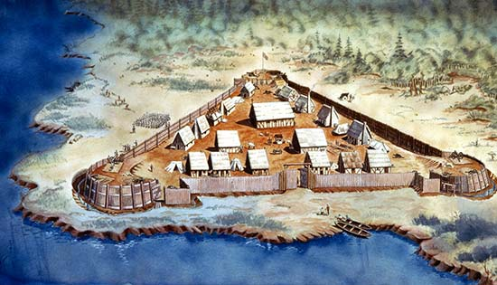
What factors did Colonists have to contend with?
#1: Trip across Atlantic was ~ 2000 miles long!
#2: Starting life over in a new unsettled area very difficult
#3: Native Americans were hostile at times
#4: Family and any support structure left behind in Europe
#5: Harsh reality of survival in the New World => Many colonies fail/struggle initially
-- Sir Walter Raleigh’s, Jamestown, Puritans, etc….
#6: Lack of Government or Bodies of law in the New World
-- No real ‘laws’, courts, police, etc….

Slide 12
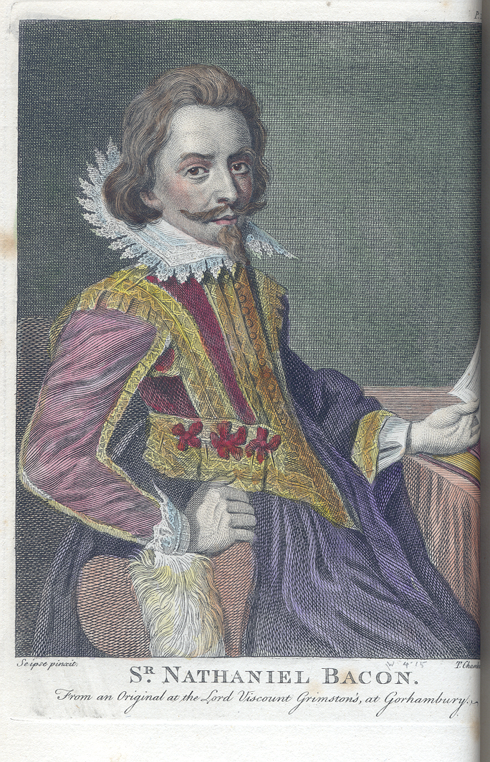
Who Came to the New World??
#1: Criminals&Escapees – desired a ‘new start’
#2: Lower classes and those attempting to escape poverty
#3: Those persecuted for their religion (i.e. Puritans, Quakers, etc. . .)
#4: Indentured Servants (majority of early colonial population)
#5: Wealthy attempting to gain vast tracts of land by paying for indentured servants
#6: Adventurers
#7: Men

Slide 13
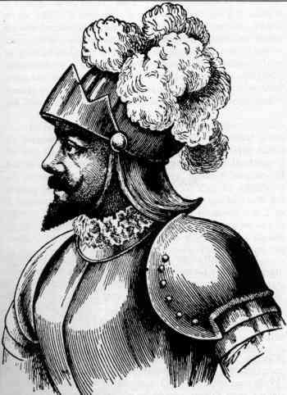
European Colonization – Story of 4 ‘Empires’
Spanish Colonization
Motives
1. Resources such as Gold/Silver; Agricultural goods such as sugar/indigo
2. Convert Natives to Roman Catholicism (missionaries establish 1st settlements)
3. Expand empire
Extent
1. Most of Central and South America; Mexico
2. Parts of US – FL, NM, AZ, TX, CA
Cultural/Economic Impact
1. Language (Spanish still spoken), Religion, architecture, intermarriages (one of 1st mother countries to do this)
-- Rigid class system => Peninsulares, Creoles, Mestizos/Mulattos, Natives/Africans
Juan Ponce DeLeon – Spanish Explorer

Slide 14
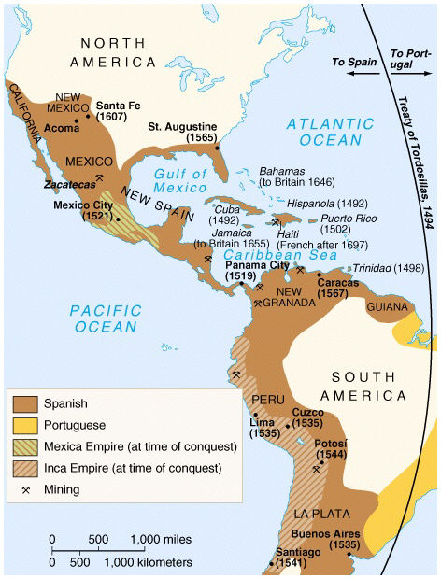
2. Introduced wheat, barley, fruit trees, horses & cattle
3. Encomienda system – Spanish crown gives Spanish citizens land in exchange for tribute (Natives enslaved to provide tribute)
Treatment of Colonies/Governance
1. No self Government for colonies
2. Crown created Viceroyalties and assigned Peninsulares to administer them
3. Squandered early advantage and resources in competition w/ Portugese
Decline
1. Spanish Armada Defeat in 1588
2. French and Indian War (1763)
3. Spanish-American war (1898)

Slide 15
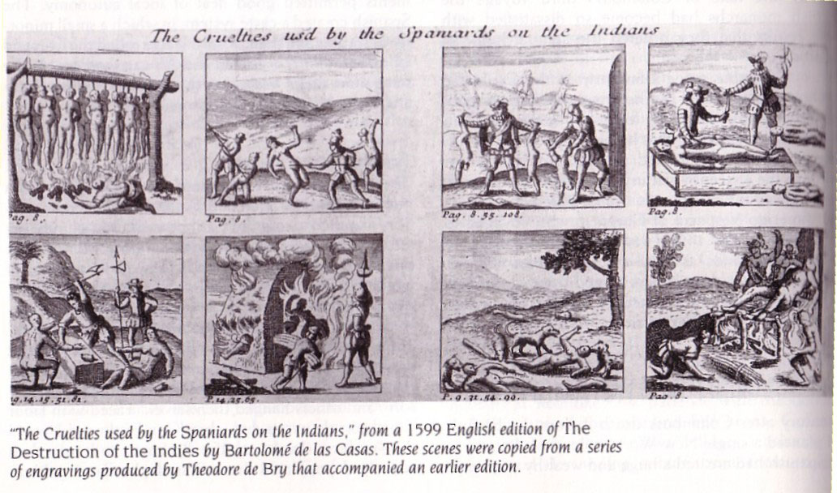

Slide 16
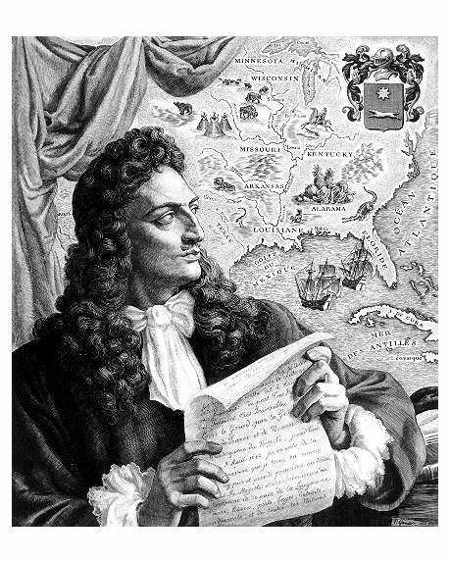
French Colonization
Motives
1. Keep up with Spain and English
2. Fish for Cod in NewFoundland
3. Trade for furs w/Natives
4. Convert Natives to Christianity
Extent
1. Canada
2. S. America in N. parts of continent
3. Louisiana & Mississippi Valley
Limited Population (New France has only ~80,000 settlers) *WHY?*
1. NO Gold or Silver
2. Only Catholics could emigrate
3. More interest in fur trade (i.e. males only come; little interest in farming)
4. Colonies had no self-government
Rene Robert De La Salle – French Explorer

Slide 17
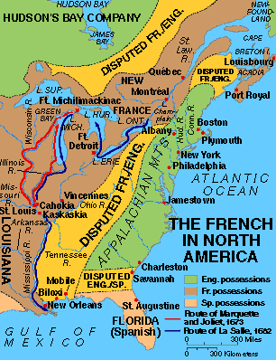
Treatment of the Colonies
1. Most powerful empire from 1620-1720 (Pop. 4x that of English and Spanish)
2. Did not focus on colonies and realize importance
3. Population never increased
Decline
-- French and Indian War (1763) => French still strong in Quebec, LA

Slide 18
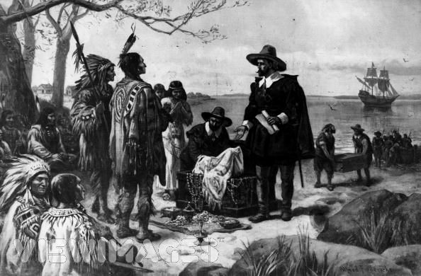
Dutch Colonization
Motive and Extent
1. Fur trade on the Hudson River
2. Manhattan Island – Peter Minuit pays $60 guilders for it from Natives!
3. Long Island, NJ and small amount in Delaware
Limited Population – allowed any nationality to live in colonies (Dutch become minority)
Decline – England became their rivals on Eastern Seaboard => English ‘invaded’ their colonies w/ settlers and established new government

Slide 19
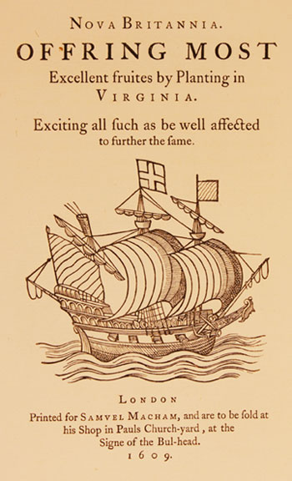
English Colonization
Motives
1. Religion – Catholics, Puritans, Quakers all want to escape persecution by Church of England
2. Political/Military – turmoil in England and some colonies pay King’s debts
3. Economic – high unemployment in England (cloth industry depressed)
-- Joint Stock Companies provided a means for people to go cheaply and government to limit investment
-- Most colonies est. by Stock Companies (i.e. London Co, Virginia Co)
4. Governmental – desire to be a world power, benefit from mercantilism
5. Social – rid England of ‘undesirables’ (i.e. criminals, lower classes, etc…)
Treatment of Colonies
1. At war w/ Dutch and French during colonial period
2. Allowed most self-government but obsessed w/ mercantilism
3. Wanted total domination of New World – went to war w/ Europeans and Natives

Slide 20
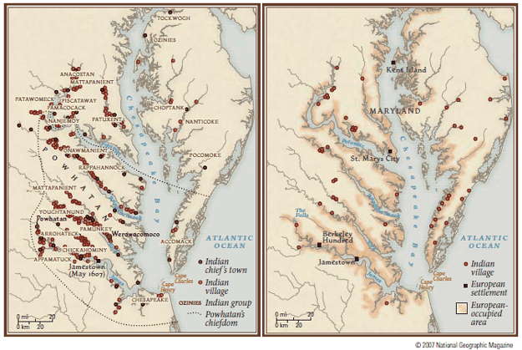
Jamestown Area – 1588 vs. 1608

Slide 21
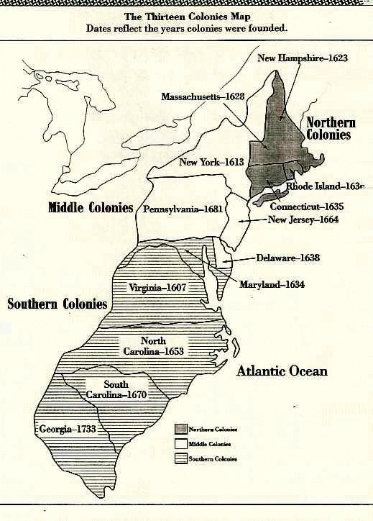
Geographical Differences in Colonies
Go over Activity – Chart on 3 Colonial Regions
-- Are Colonies 1 ‘country’ or 3 separate ones in the Colonial region? Why?

Slide 22
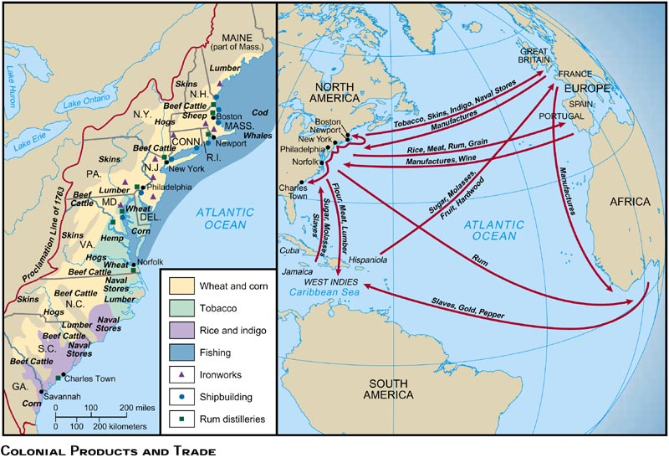

Slide 23
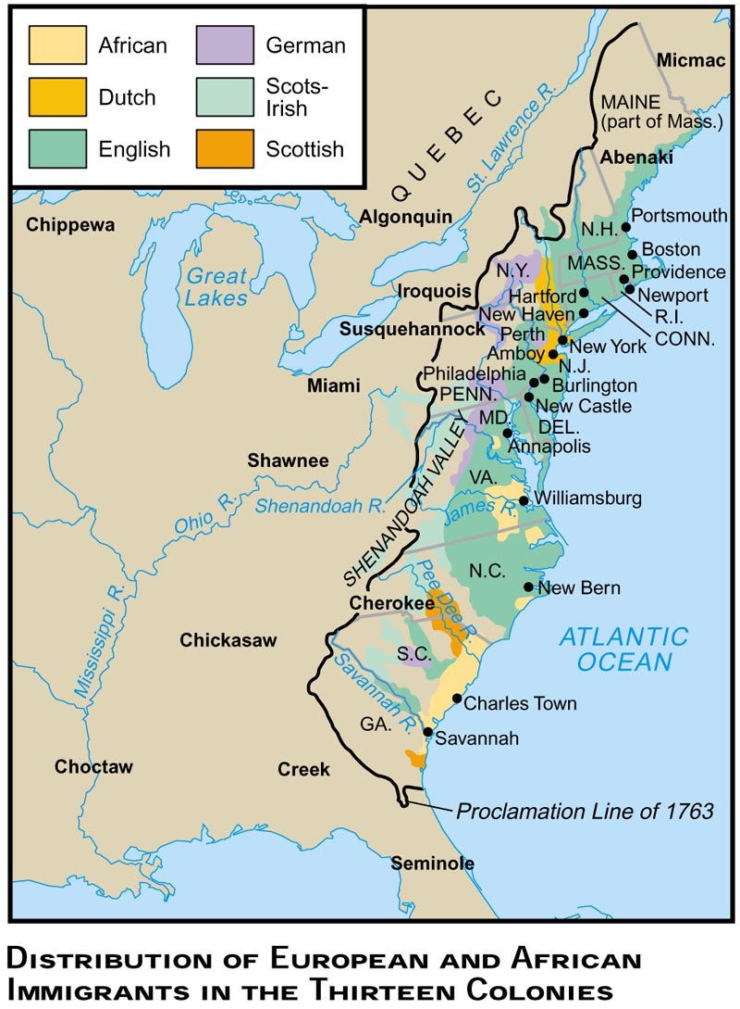

Slide 24
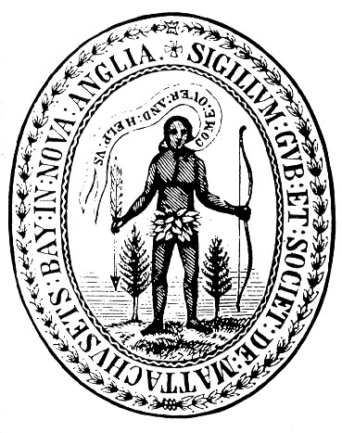
Religion in America – Puritanism and American Culture
Puritanism in America
Charles I becomes King (anti-Puritan) and persecutes Puritan followers
1. John White forms Mass. Bay Company and Puritans leave England
2. Colony in Mass. Bay w/ Boston as Capital
3. Colony had an elective form of Government w/ “deeply religious” Males as the electorate
-- Church members must have ‘conversion’ experience and thus become part of ‘elect’
-- Elect John Winthrop as 1st Governor
4. Massachusetts to them was to be a “City on a Hill” to educate and change the world
a. Start of idea of “American Exceptionalism” => America is somehow special and outside of corruption and degredation of Europe
b. Puritans believed that God spoke of America as the “New Jerusalem”
** Does America still think of itself as “Exceptional”?**

Slide 25
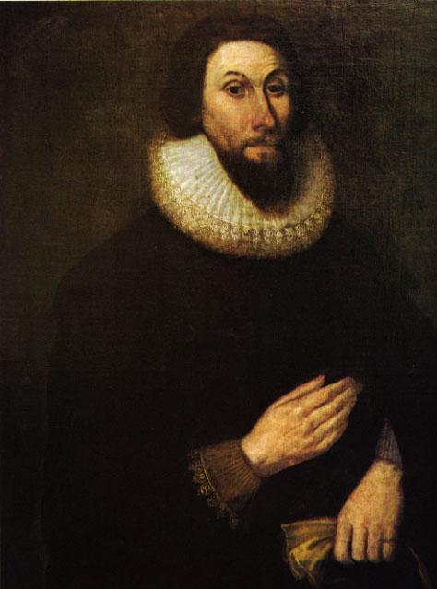
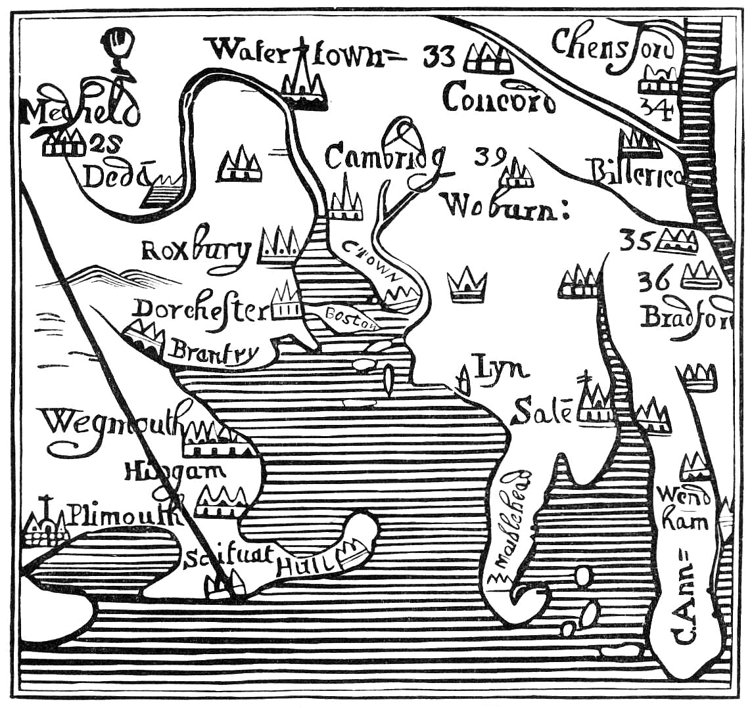
John Winthrop

Slide 26
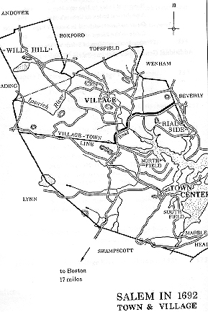
Salem Witch Trails – (1692-1694)
2 ‘Salems’ exist by 1692 – Town (urban, commercial) & Village (Farmers, poor)
Villagers (‘original’ Puritans) worried about “sinful” town and loss of power
Starts w/ group of young girls who claim to have been “bewitched” by older town women
-- Symptoms = hallucinations, convulsions, slurred speech
Soon other villagers develop symptoms & begin accusing people (150 +)
1. No proper colonial government so local courts hear cases
2. 20 witches convicted and executed – those confessing were not executed
3. In 1693 Mass. Gov. Phips w/ help of Increase Mather ended trials
Aftermath
-- Trials revealed class, urban/rural tensions in society
-- Example of “Mob Hysteria” (1st such example in US History) => Others????

Slide 27
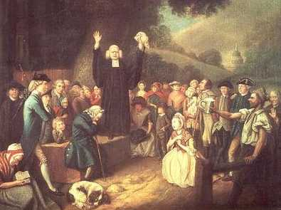
The Great Awakening (1730-65)
By 1730’s the Enlightenment caused a general decline in religiosity in America
-- Enlightenment = Belief that men are endowed w/ reason to discover the “natural laws” that the earth runs by
-- God = ‘Watchmaker’
By 1730 many are disillusioned w/ Puritanism’s strict rules and hypocrisy
1. Half-Way Covenant – in order to boost membership the Puritans decided that you could be a ‘member’ w/o a ‘conversion’ experience
2. George Whitefield & Johnathan Edwards challenge “Old Light” preachers
3. “New” Religion stresses personal experience w/ God
-- No “preacher”/church needed
-- Appeals to poor, blacks, etc…
4. 1st truly “national” event – helps bring colonies together
-- Also challenged traditional religious/political authority
George Whitefield Preaching to a crowd

Slide 28
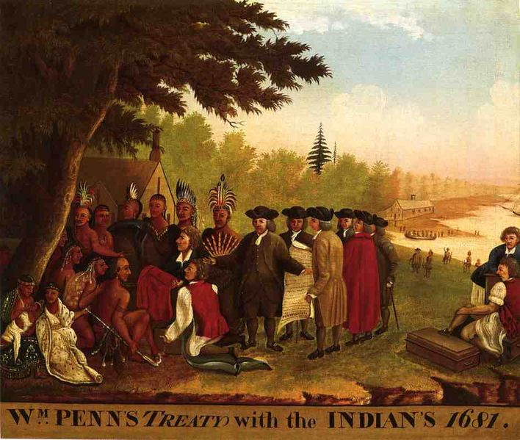

Slide 29
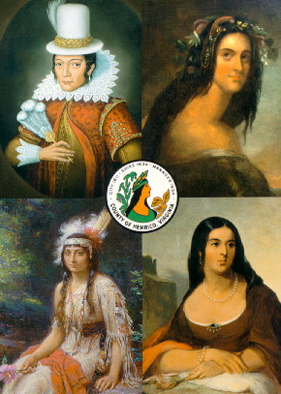
Indian Relations – War and Assimilation
Background – 2 ideas for Warfare
Native Americans & Europeans came from 2 different cultures concerning warfare
1. Europeans = war is “Total” (i.e. civilian, military, etc…) & fought for dominance
2. Natives = war is ritualistic and fought for sport and honor, not destruction
*Cultural Clash causes misunderstanding, change of Indian culture & loss of life *
Indian vs. Settler Wars
#1: Powathan Wars – Chesapeake & VA
a. 1st Powathan War (1614) – small skirmishes and fighting over land in Chesapeake area
-- Ends w/ Pocahontas/Rolfe marriage
b. 2nd Powathan War (1644) – Natives attempt to remove colonists from VA
-- Natives lose in bloody battles => 1646 peace treaty bans Natives form VA and creates 1st ‘reservation’ in West
Different depictions of Pocahontas

Slide 30
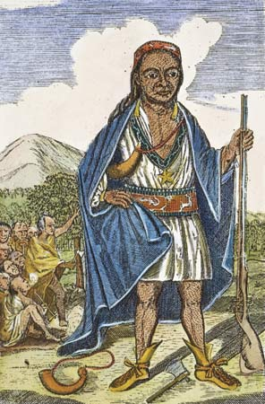
Indian Wars (Cont.)
#2: Pequot Wars – Massachusetts/Conn (1637-39)
a. When “Pilgrims” 1st arrive in 1621 Natives welcome them and aid survival
-- 80% of Natives had already died due to smallpox given to them by fishermen
b. By 1637 Pequots refuse to continue to move off their land for English
c. English create a pretense for full scale war – killing of trader John Stone
d. War ends w/ burning of Mystic village and annihilation of Pequots
#3: King Phillips War – Mass./Conn. (1675-76)
a. After decades of peace Indian chief Metacom (Phillip) unites Tribes against English
b. 600 colonists, 3,000 Natives dead – Natives never challenge colonists again
-- Phillip beheaded &family sold to slavery
#4: Pope’s Rebellion – New Mexico (1676)
a. Spanish missionaries ban Native religious symbol (Kachina Dolls)
b. Native Leader Pope unites tribes against Spanish => drives missionaries back to Mexico for more than a decade
King Phillip (Metacom)

Slide 31
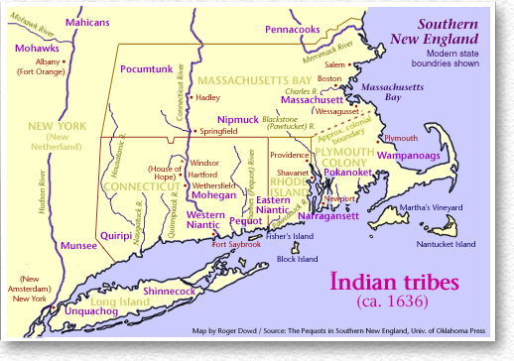

Slide 32
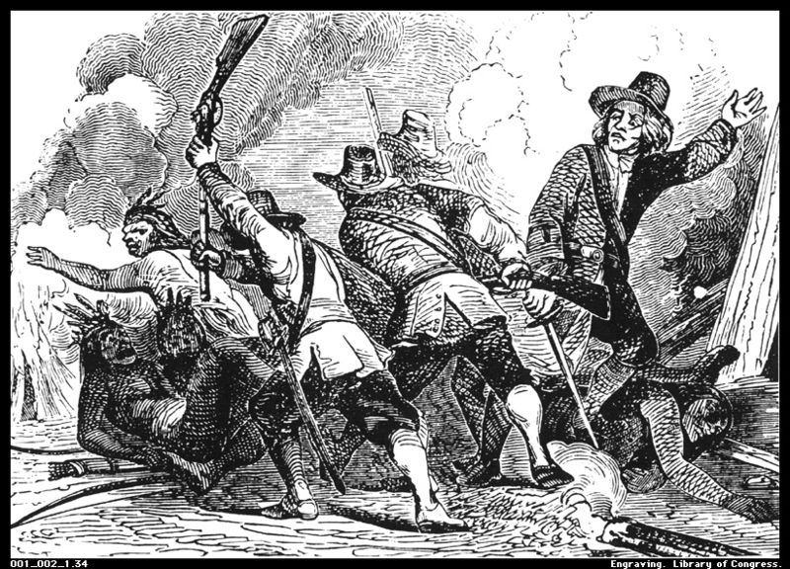
Why did the Colonists Always “Win”?
#1: Superior Weapons (i.e. rifles, gunpowder, etc…)
#2: Stable agricultural output (i.e. Native crops)
#3: Strong manufactured goods (i.e. imports)
#4: Immunity to European Diseases (i.e. smallpox)
#5: Detailed political organizations & ability to divide Native tribes

Slide 33
Triangular Trade – Detailed Map

Slide 34
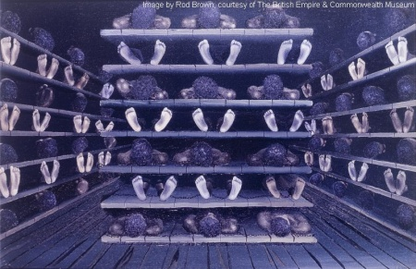
The “Middle Passage”

Slide 35
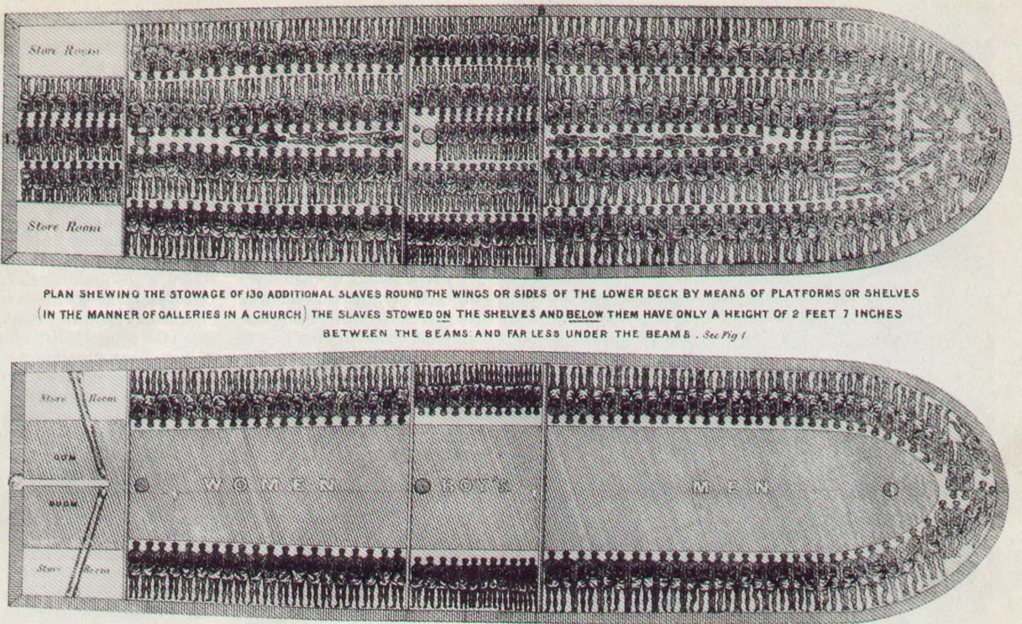

Slide 36
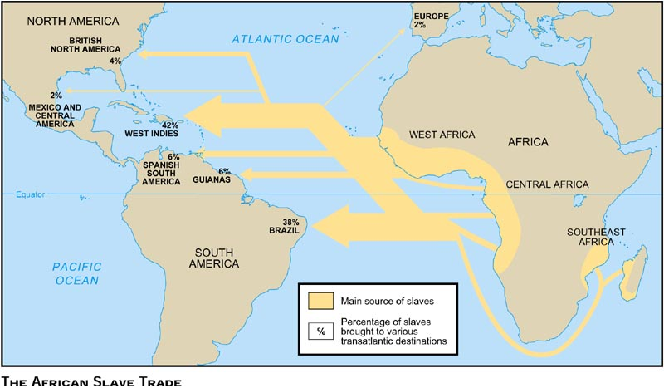

Slide 37
Life in the 3 Colonial Sections
New England Society
Less ethnically diverse than other colonial sections due to harshness of Puritan religion and rocky soil (creates a stubborn resourcefulness in people)
NE had the most diverse economy in all regions – primarily focused on trade/industry
1. Shipbuilding, fishing, forestry
2. Good natural harbors
3. More urbanized w/ more professional workers (i.e. doctors, clergy, lawyers)
4. Little slavery due to economy and geography
Very religiously focused society w/ Bible/church as central in community
-- Religion formed the basis for laws & governmental decisions/leadership/voting
Family oriented society – families emigrate together usually
-- Religion emphasized familial ties w/ divorce illegal – except in adultery (A)
-- Less independence and rights for women in general due to patriarchal society
Very democratic, tight knit social institutions develop
1. Strong local/state governments w/ chartered towns
2. Town Hall meetings (“direct democracy”) & town “commons” where militia trained
3. Propertied males that were church members voted
4. Public educational system required in towns of 50+ (1st Universities in NE => i.e. Harvard, Yale, etc…)

Slide 38
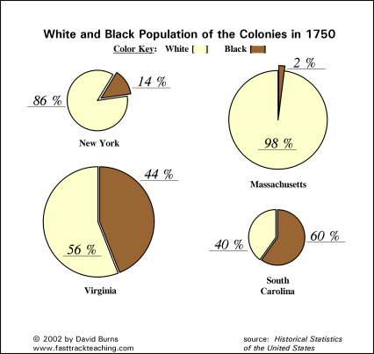

Slide 39
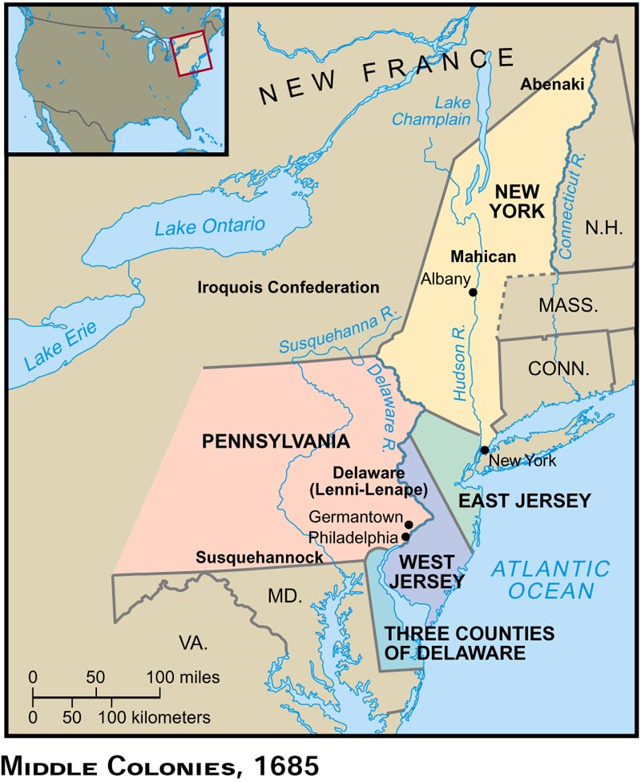
Middle Colonies
Ethnically mixed society, religiously tolerant & democratic society
Abundance of land leads to a more “frontier” based society
-- Largest cities of NY & Philadelphia
Good Native Relations, peaceful in general
Private education only
“Middle” Road between excesses of N &S
Southern Colonies
Southern society less economically & ethnically diverse than all other sections
-- Economy dependent on slave labor & cash crops of tobacco/cotton
Society very hierarchal & class oriented
1. Top = Large Planters (~1-2%); Large farms w/ 25+ slaves; 70% of all wealth
2. Middle = small independent farmers; few (10 -) slaves
3. Bottom = Landless whites, farm hands
4. Servants = Ind. Servants or blacks
Very isolated society based around plantations & waterways w/ great tension and discontent (rich control economy, society and government)
No educational system => rich hired tutors

Slide 40
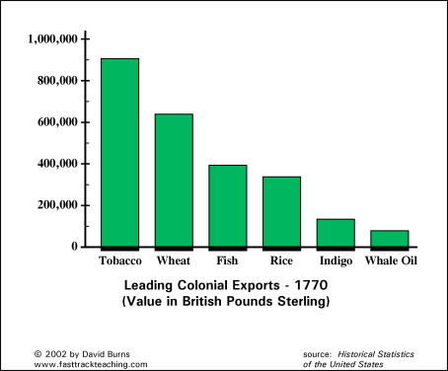

Slide 41
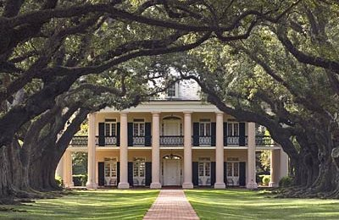
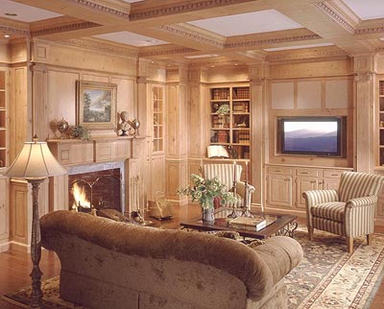
Southern Society – A Tale of Two Extremes

Slide 42
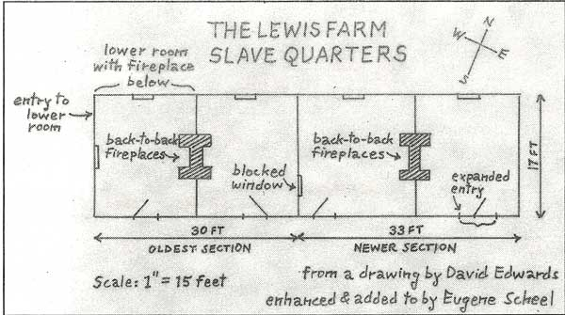
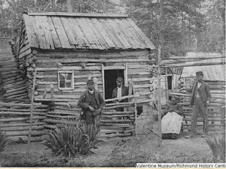

Slide 43
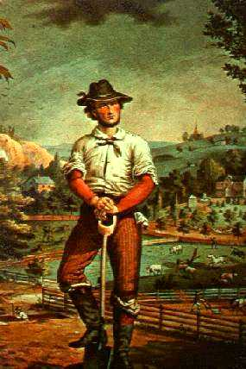
Colonial Life in General
Freshness/cleanliness of environment led to an average of a 10 year increase in lifespan!
-- Average age of Puritans ~ 70!
America was a land of prosperity & relative freedom compared to Europe
Life in the colonies was “hard” compared to modern day => 90% of Americans farmers
-- Average Day = Rise at dawn, chores and farming all day, bed at 6-7pm!
-- Work divided based on gender
Idealized “Yeoman” Farmer

Slide 44
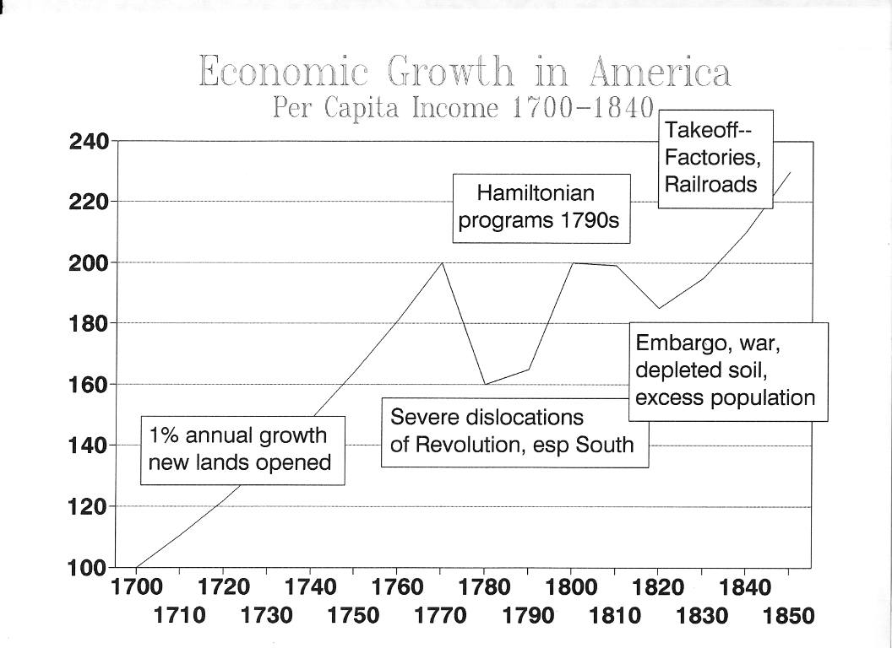

Slide 45
Democracy and American Sense of Unity Pre-1754
Was America 1 society or 3 separate societies in 1754? Was America united?
A. Factors contributing to DISUNITY
1. Regional differences in economy, religion, demographics, slavery, culture, urbanization, education, colonial governance, etc……
2. Lack of speedy travel methods means most do not EVER travel more than 25-50 miles from where they were born!
B. Factors which contribute to American UNITY
1. 3,000 mile distance from England & European continent
2. Wilderness & Initiative required to survive in America
-- Difficulty of “making” it in America => crops, Natives, disease
3. Religious Movements (i.e. Great Awakening, Puritanism, religious independence from Europe) => provides a sense of uniqueness and stress “American”values like hard work and initiative
-- 75% of Americans adhere to a faith by 1765
Democracy in America – seeds of US governmental structure
A. How Democratic were the colonies?
-- Wealthy vs. Poor? Men vs. Women? Black vs. White? White vs. Native?
-- Who votes in Colonial America? Is this Democracy???

Slide 46
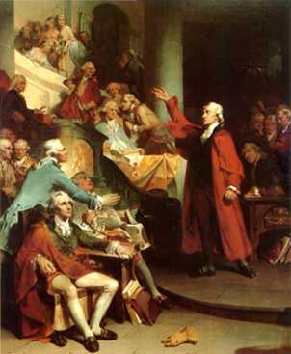
Roots of Democracy in America
Virginia House of Burgesses – 1619
a. Landowning males elect reps. to pass laws that govern colony
b. 1st elected legislature in America
2. Mayflower Compact – 1620
a. Pilgrims made a pat to “enact and obey just and equal laws”
b. 1st written constitution in America
c. Characteristics = “direct Democracy”, Rule by majority
3. New England Town Meetings
-- All landowning males gather to make local decisions
4. New England Confederation
a. 4 Colonies (primarily aristocrats) ban together for: defense against Natives; inter-colonial problems
b. Each colony given 2 votes in legislature – MD & RI banned from joining
5. Fundamental Orders of Conn. – 1639
a. One of 1st written Constitutions
-- Elected Governor & laws should express will of majority
6. Lord Baltimore passes Acts of Toleration
-- Guaranteestoleration to all Christians

Slide 47
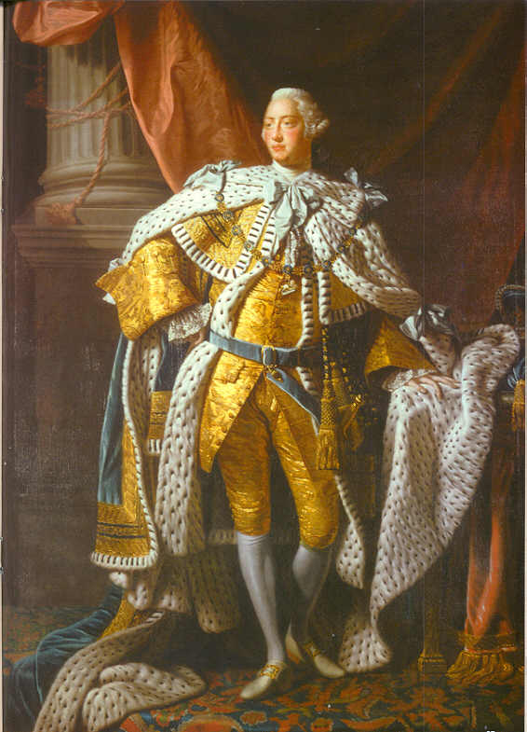
Status of Colonial Governments?
By 1754:
1. 8 Colonies were Royal Colonies: King selects Governor & Upper House; Voters elect Lower House
-- VA, MA, N/SA Carolina, GA, NJ, NY, NH
2. 3 were Proprietary Colonies => Proprietor selected Governor; Voters elect Assembely
-- DE, MD, PA
3. 2 were Self-Governing Colonies (CT, RI)
-- Voters elect governor and Assembelies

