Slide 1
Postwar America
1950’s

Slide 2
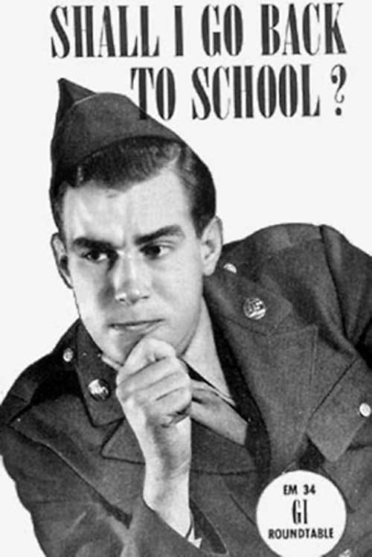
Peacetime Legislation
GI Bill
Provide funds for veterans to: start businesses, buy homes, and attend college

Slide 3
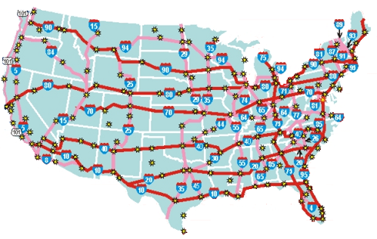
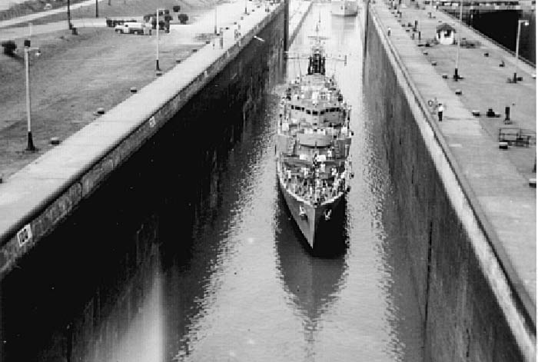
Dynamic Conservatism
Balancing conservative economics with activism
Conservative Economic Policies
Ends a number of government regulations on businesses like price controls
Cuts Federal spending
Abolished or cut funding to some New Deal programs such as the TVA
Activist Policies
Passed the Federal Highway Act (largest public works program in U.S. history)
Constructed St. Lawrence Seaway (allows travel from the Great Lakes to the Atlantic)

Slide 4
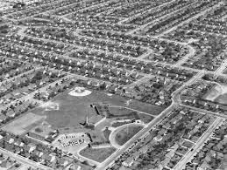
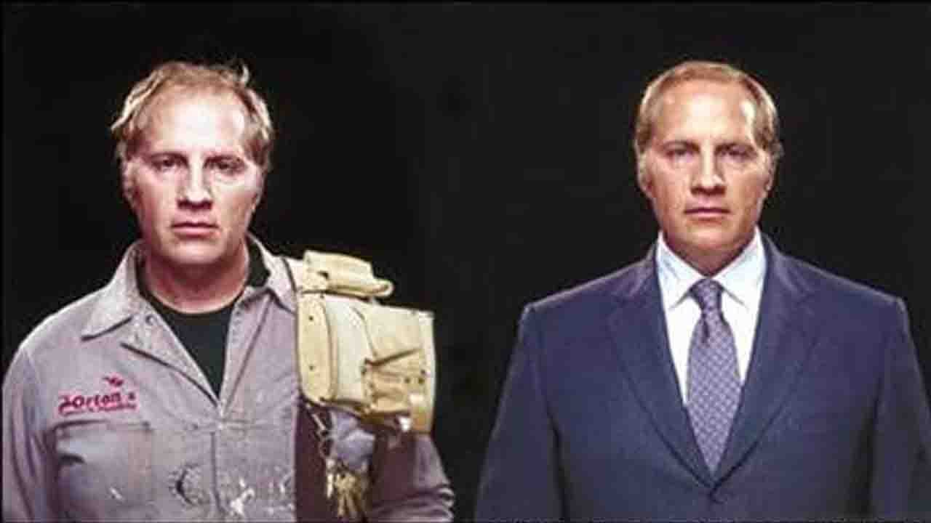
Prosperity in America
1940-55 average income triples
Suburbia grows
Mass production applied to housing (Levittown – 1st suburbs in NY)
Baby Boom - 1945-61 65 million children born
White-Collar workers include professionals such as doctors and lawyers, engineers, salespeople, managers, and office staff. Most receive a weekly or yearly salary rather than an hourly wage. Because white-collar employees worked in offices, they could wear white shirts to work without fear of getting them dirty. Blue-collar workers are people who work in factories or at skilled trades, such as plumbing or auto repair. By the end of the 1950s, the workforce looked different. For the first time in history, white-collar workers outnumbered blue-collar employees.

Slide 5
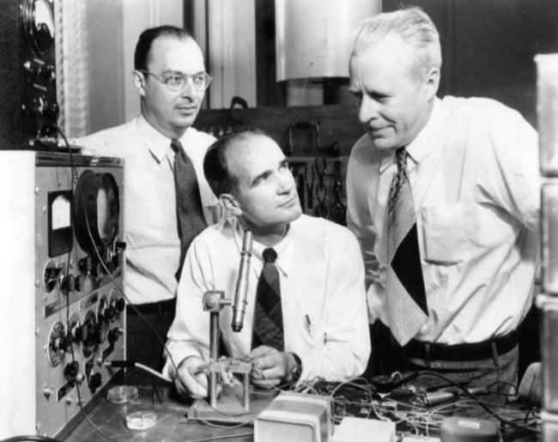
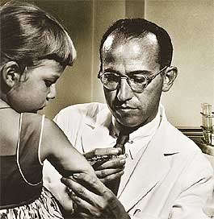
Advances in Science
Electronics
The transistor
Smaller cheaper radios
Essential for modern electronics
ENIAC and UNIVAC early military computers
Aviation
New designs, materials, and engines allow for further and cheaper flight
Medicine
Radiation and chemotherapy treatments
CPR (Cardiopulmonary Resuscitation)
Pacemakers
Blood tests and antibiotics help fight TB
vaccine for polio (Jonas Salk)

Slide 6
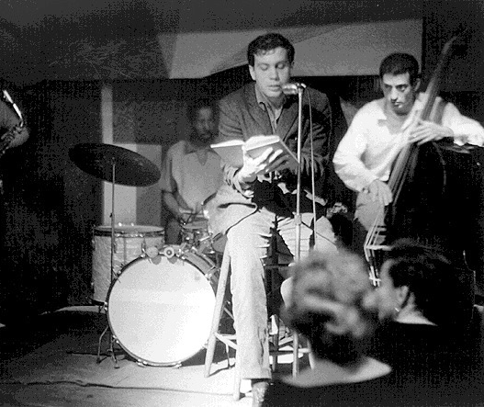
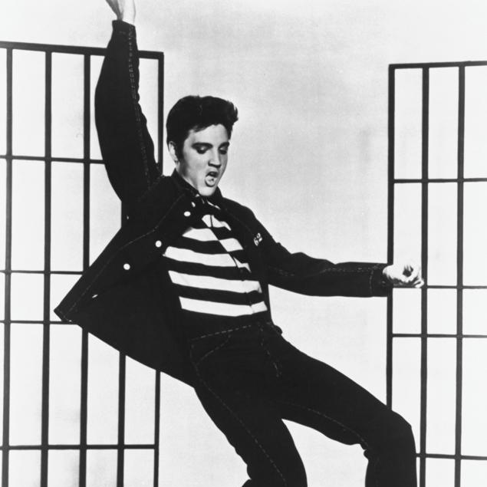
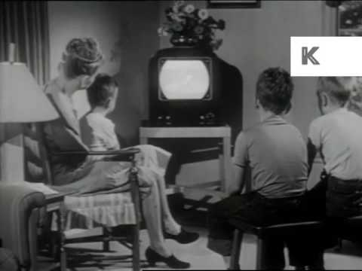
Culture
Rock’n’Roll
Electric instruments
Based on popular African American and country music
Beat Movement
Poetry and literature
Criticizes American Culture for shallowness and conformity
Allen Ginsberg and Jack Kerouac
Laid foundations for cultural revolution in the 60’s
Television - Challenges radio and spread new cultural concepts quickly

Slide 7
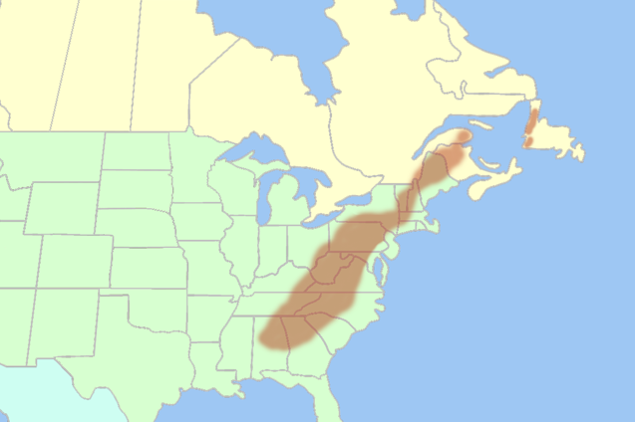
Poverty
African Americans
Hispanics
Native Americans
Appalachians

Slide 8
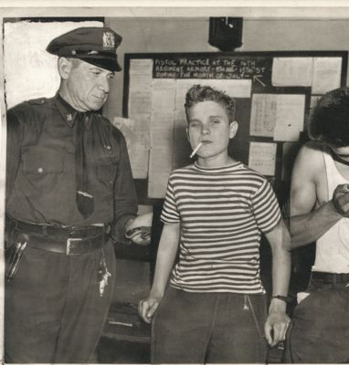
Juvenile Delinquency
Antisocial or criminal behavior of young people
Stereotyping youth (especially those who broke norms of mainstream culture, long hair, language)
Explanations
Television
Movies
Comics
Racism
Parents are too busy
Divorce
Too much conformity
Efforts to improve school system

Slide 9
https://www.youtube.com/watch?v=Pub1siWxRd0

